Slide 1
The Apostle Paul’s Voyage To Rome
Acts Chapter 27 – Josh
Acts Chapter 28 – Morgan
Acts 23:11, 27:24, 25:10-12, 26:32

Slide 2
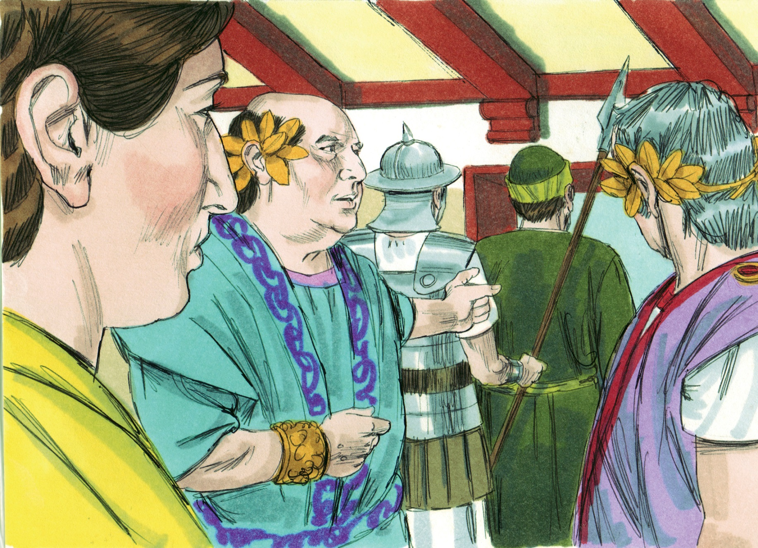

Slide 3
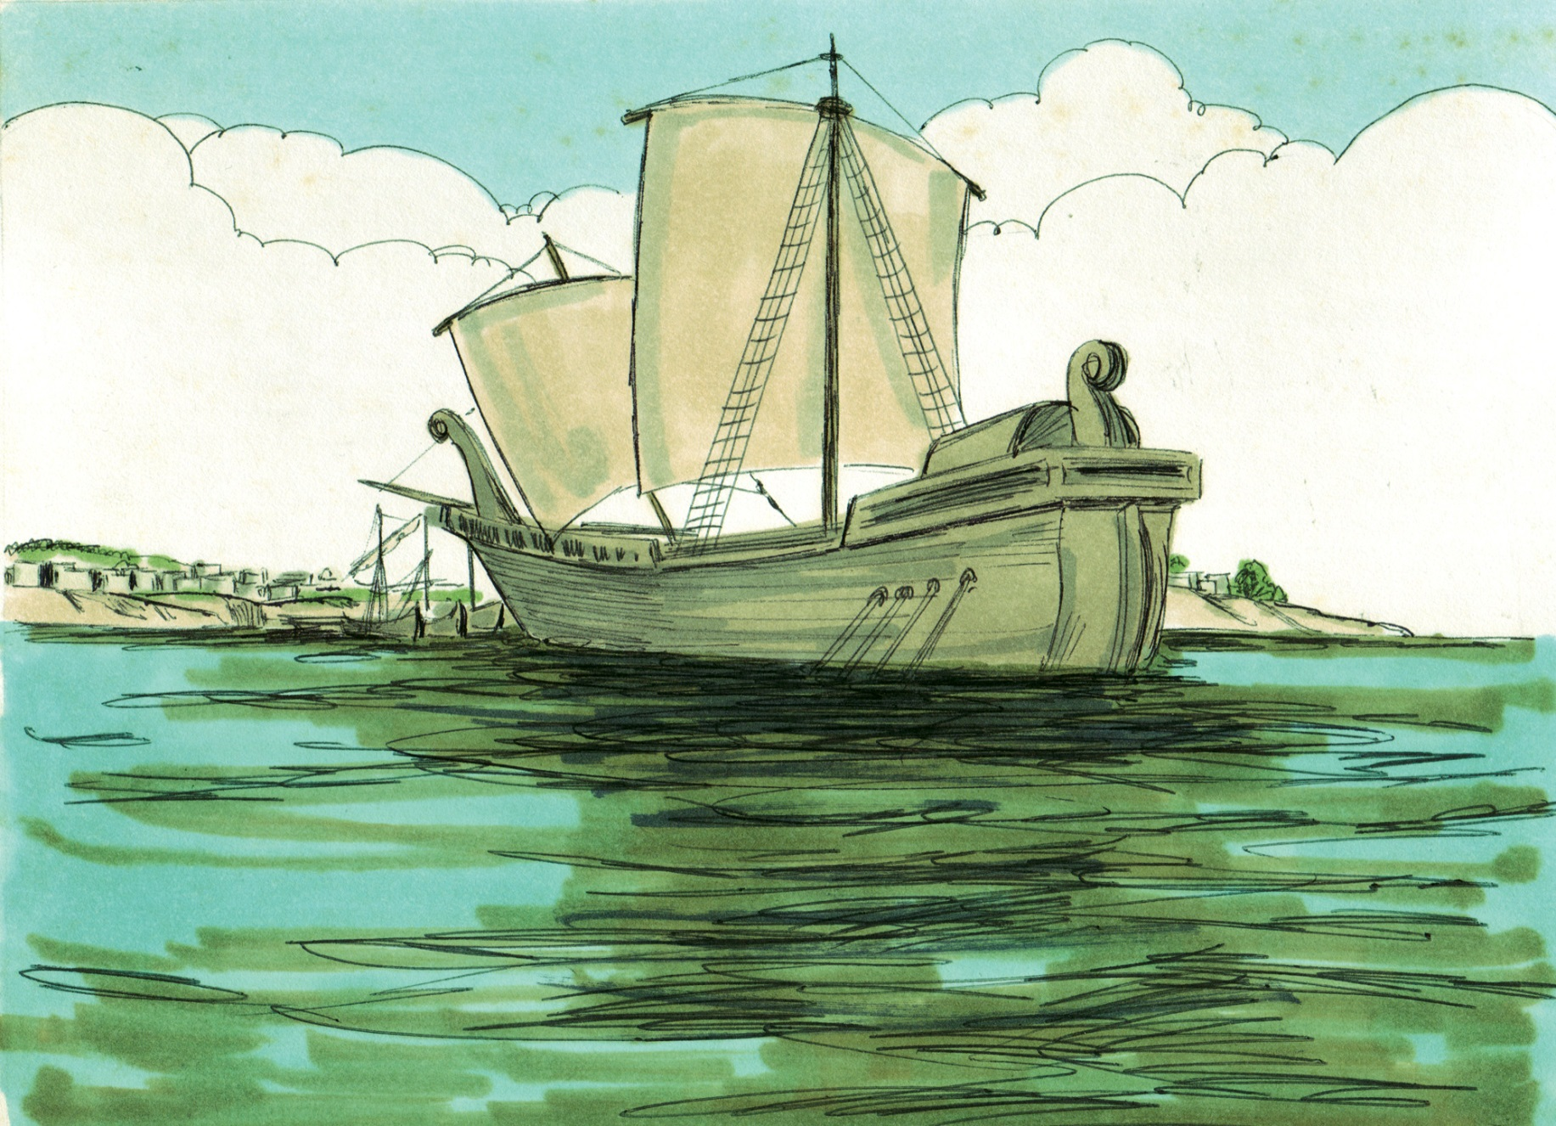

Slide 5
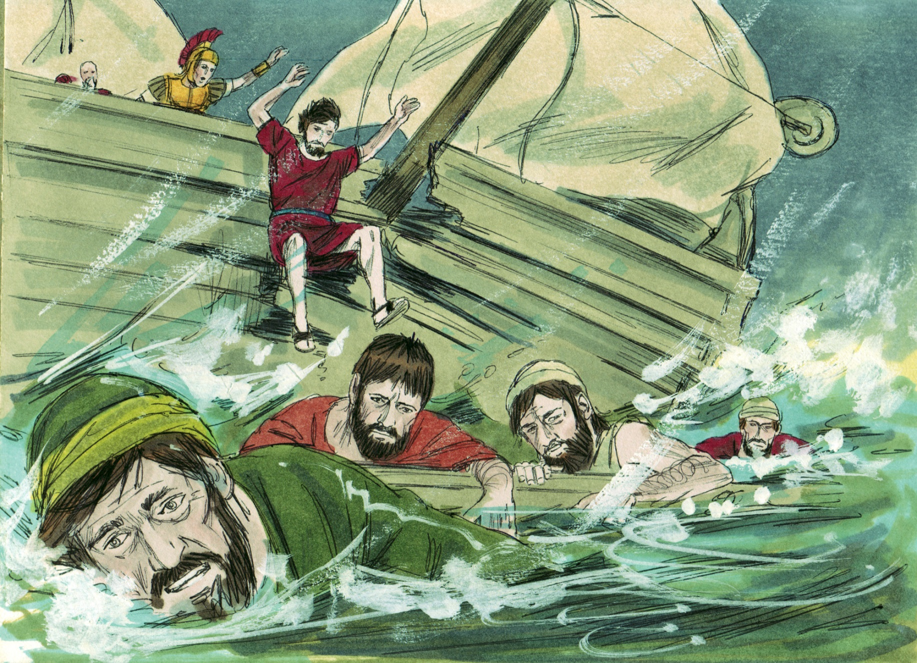

Slide 6
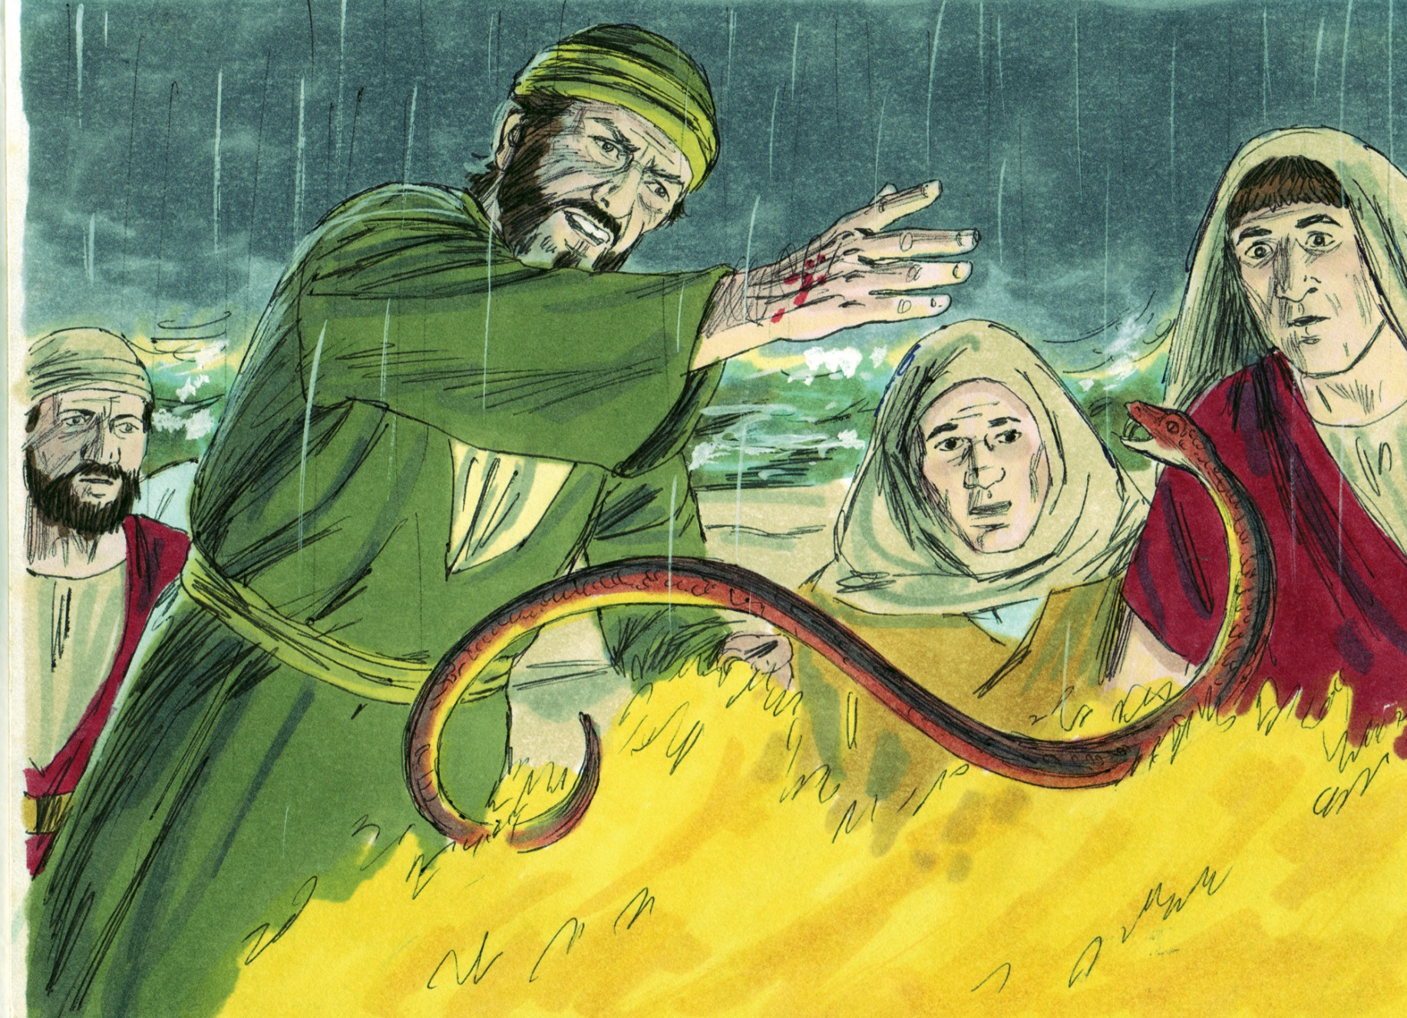

Slide 7
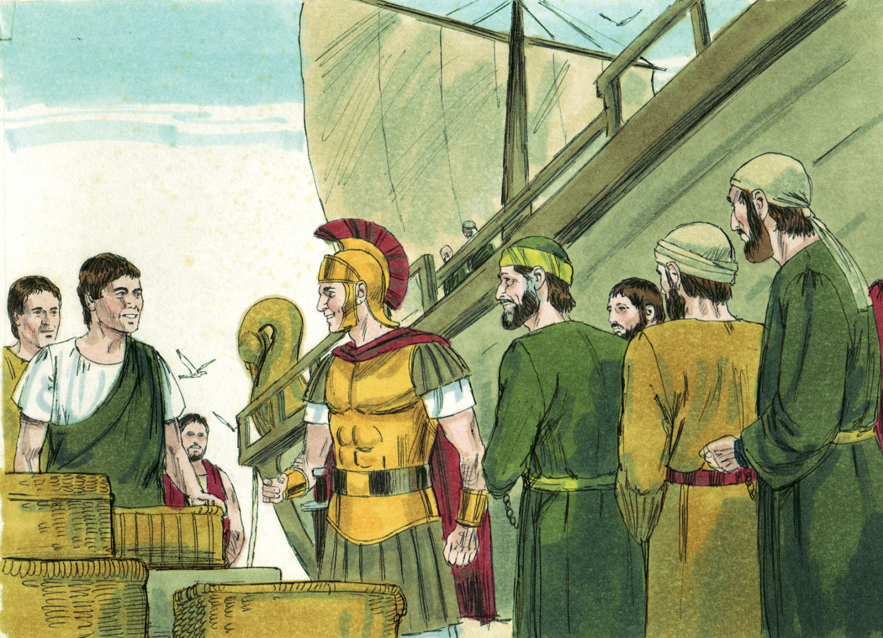

Slide 8
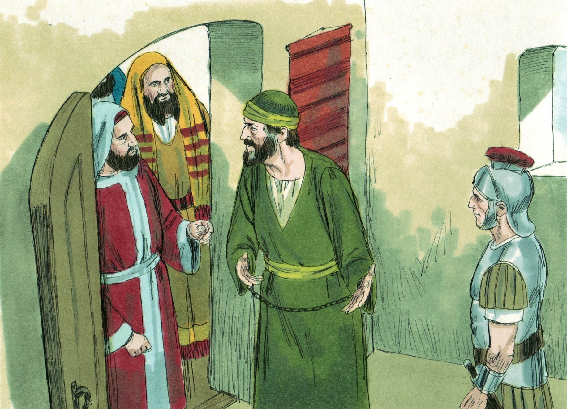

Slide 9
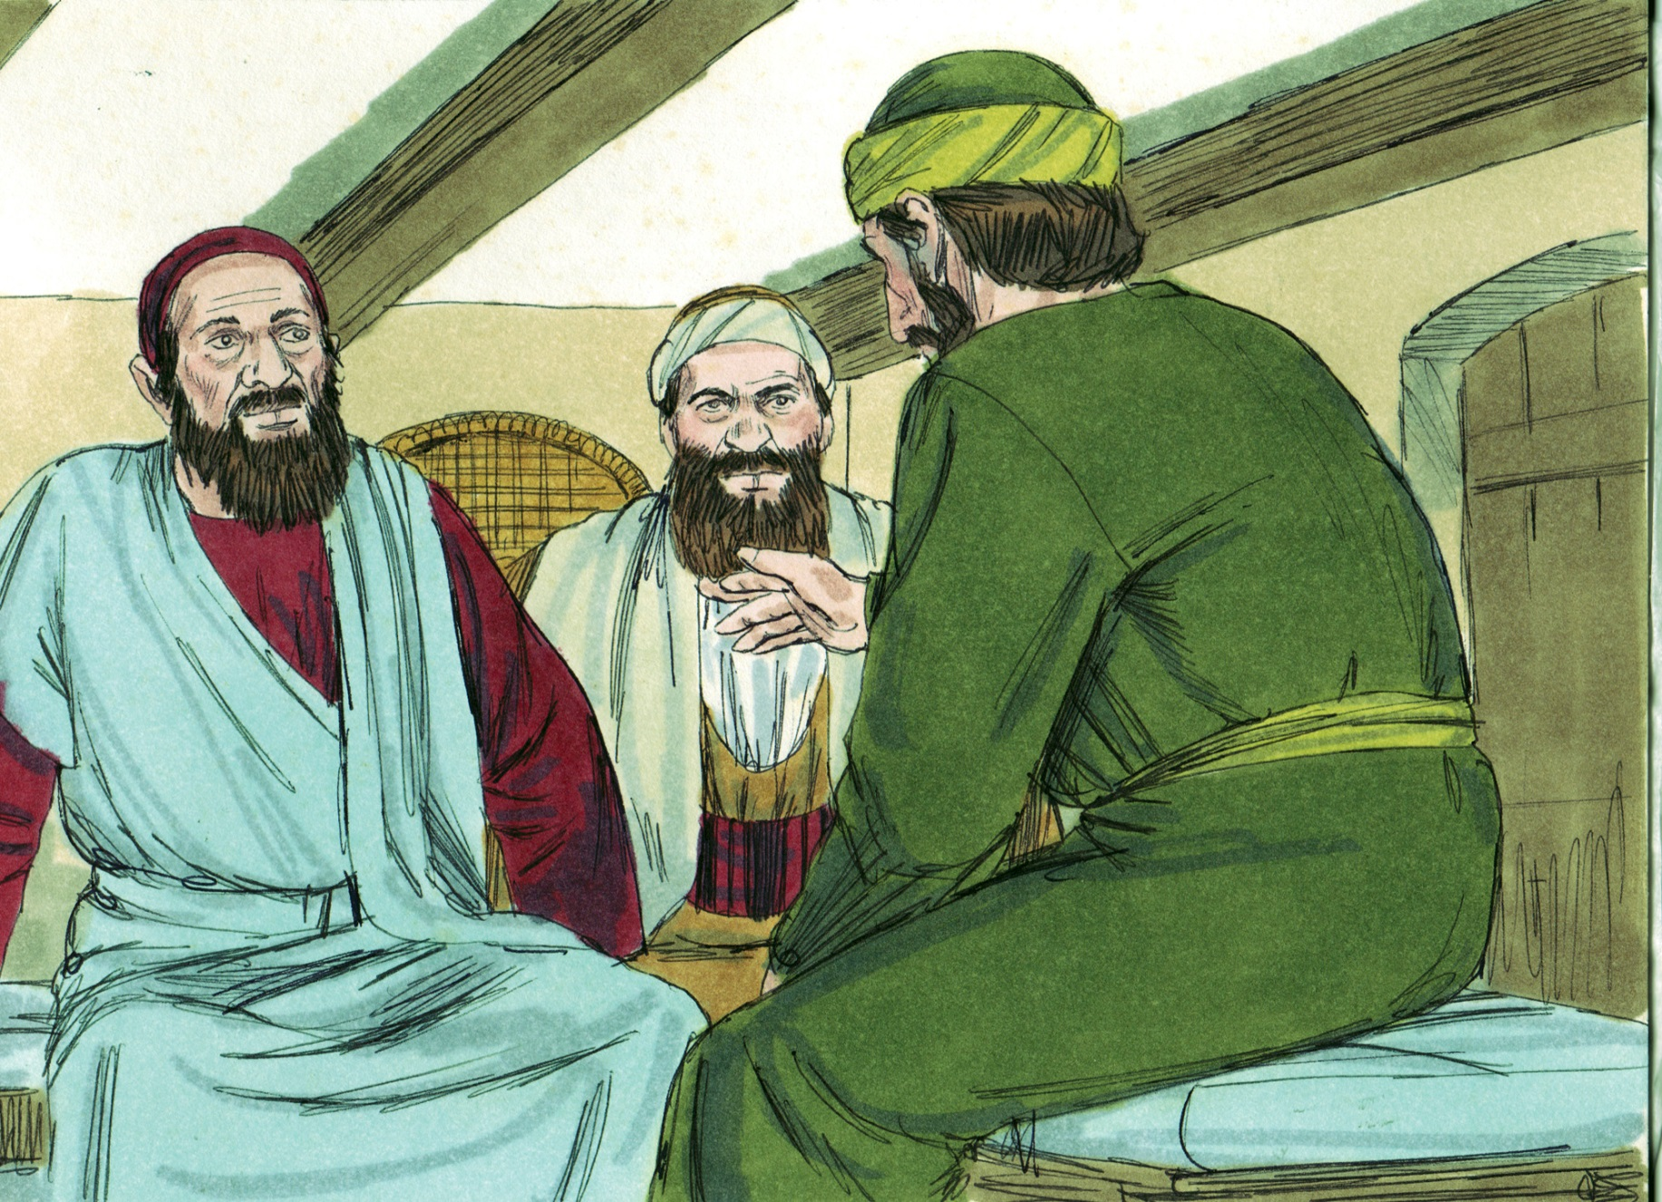

Slide 10
The Apostle Paul’s Voyage To Rome
Paul’s trip was full of uncertainties (Philippians 4:6-7)
We may be tempted to abandon ship (Acts 27:31, 1 Timothy 1:18-20)
God watched over Paul and the others (Matthew 5:43-48)
Liberties are given to peaceful disciples (1 Timothy 2:1-4, Acts 27:3, 43, 28:14-16, 30-31)
Paul could relate to being in isolation (Acts 28:11, 30)
Opportunities made for the lost (Acts 28:17, 30-31)
Productive for the Lord (Matthew 6:33-34)
Paul did not complain, but was busy for the Lord (Philippians 1:12-14, 4:21-23, 2 Tim. 4:2)
Preach the word of God no matter what (1 Corinthians 9:19-23, Jude 20-23)

Slide 11
The Apostle Paul’s Voyage To Rome
What about you and me?
Will we be like Paul and make the most for the Lord of the circumstances we are in?

Slide 12
The Apostle Paul’s Voyage To Rome
You know what motivated Paul the most?
He wanted to be with the Lord for eternity (Titus 3:4-7)!
If you have not become a Christian this morning, you do not have any hope to live eternally. Jesus wants you to join His body, get on His ship. And then trust Him and follow Him to be saved eternally (Galatians 3:26-29).

