Slide 1
Genesis 8:18-9:17

Slide 2
The rainbow not only stands for a promise God has made, it also says a number of things to us today.
What does the rainbow say?

Slide 3
WHAT DOES THE RAINBOW SAY?
God Is Alive

Slide 4
WHAT DOES THE RAINBOW SAY?
God Keeps His Promises

Slide 5
WHAT DOES THE RAINBOW SAY?
God’s Word Is Always True

Slide 6
WHAT DOES THE RAINBOW SAY?
God Takes Sin Seriously

Slide 7
WHAT DOES THE RAINBOW SAY?
God Is Longsuffering

Slide 8
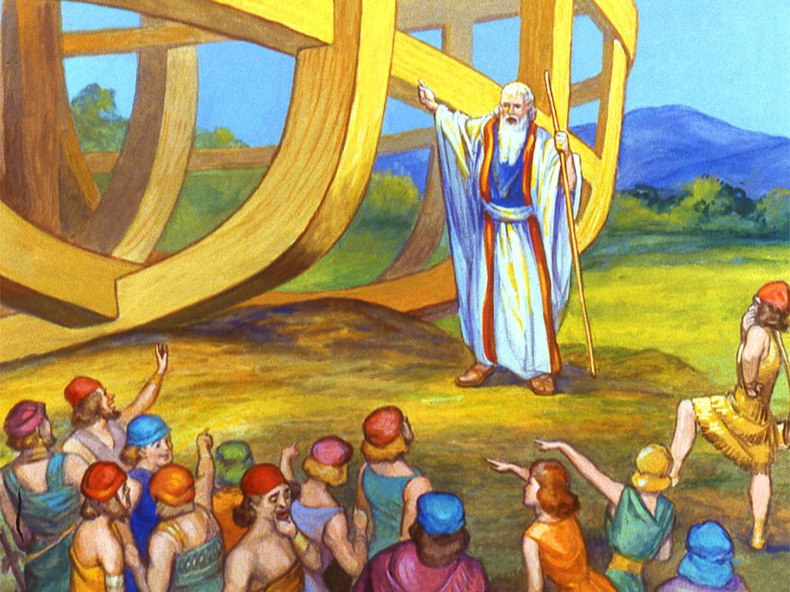
WHAT DOES THE RAINBOW SAY?
God Is Longsuffering

Slide 9
WHAT DOES THE RAINBOW SAY?
God Wants A Personal Relationship With You!

Slide 10
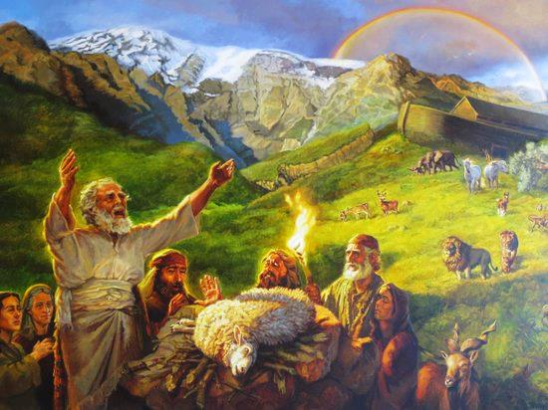
WHAT DOES THE RAINBOW SAY?
God Wants A Personal Relationship With You!

Slide 11
WHAT DOES THE RAINBOW SAY?
God Gives Grace To The Faithful And Obedient

Slide 12
Noah Was Saved By:
Grace (Genesis 6:8)
His Faith that moved him to Obey (Genesis 6:22, Hebrews 11:7)
Water (1 Peter 3:20-21)

Slide 13
THE RAINBOW TEACHES US MANY THINGS!
God Is Alive
God Keeps His Promises
God’s Word Is Always True
God Takes Sin Seriously
God Is Longsuffering
God Wants A Personal Relationship With You
God Gives Grace To The Faithful And Obedient

Slide 14
God wants a personal relationship with you today!

Slide 15
The next time you see a Rainbow in the sky, remember what it teaches.
We will close with Ezekiel 1:26-28.

