Slide 1
1 Corinthians 6
There IS a stark contrast between A Christian and the world
Passages are copied from the English Standard Version (ESV)

Slide 2
outline
1-10, Put away sins of self-gratification
11, Recognize your state of being justified
12-19a, Do not be tempted to become part of the world again
19b-20, Serve God as your master

Slide 3
PUT AWAY SINS OF SELF-GRATIFICATION
Paul condemns taking Christians to court – v. 7 “To have lawsuits at all with one another is already a defeat for you. Why not rather suffer wrong? Why not rather be defrauded?”
Paul recommends:
Using a wise person as an arbiter (v. 5)
Being defrauded (v. 7)
Why?
Philippians 2:1-11
To be Christ like and less worldly – Romans 12:1-2

Slide 4
PUT AWAY SINS OF SELF-GRATIFICATION
Philippians 2:15 (ESV): “…that you may be blameless and innocent, children of God without blemish in the midst of a crooked and twisted generation, among whom you shine as lights in the world…”
Romans 12:1-2 (ESV): “I appeal to you therefore, brothers, by the mercies of God, to present your bodies as a living sacrifice, holy and acceptable to God, which is your spiritual worship. Do not be conformed to this world, but be transformed by the renewal of your mind, that by testing you may discern what is the will of God, what is good and acceptable and perfect.
Matthew 7:13 (ESV): “Enter by the narrow gate. For the gate is wide and the way is easy that leads to destruction, and those who enter by it are many.”
1 John 2:15-17 (ESV): “Do not love the world or the things in the world. If anyone loves the world, the love of the Father is not in him. For all that is in the world—the desires of the flesh and the desires of the eyes and pride of life—is not from the Father but is from the world. And the world is passing away along with its desires, but whoever does the will of God abides forever.

Slide 5
PUT AWAY SINS OF SELF-GRATIFICATION
Or do you not know that the unrighteous will not inherit the kingdom of God? Do not be deceived: neither the sexually immoral, nor idolaters, nor adulterers, nor men who practice homosexuality, nor thieves, nor the greedy, nor drunkards, nor revilers, nor swindlers will inherit the kingdom of God.
These sins of self-gratification
will keep you from Heaven!

Slide 6
Recognize your state of being justified
You were Washed
Or “you washed”
Or “you have got yourselves washed”
Point action is necessary!
Acts 22:16 “And now why do you wait? Rise and be baptized and wash away your sins, calling on his name.”
Washed = Baptism =
Washing Away of Sins

Slide 7
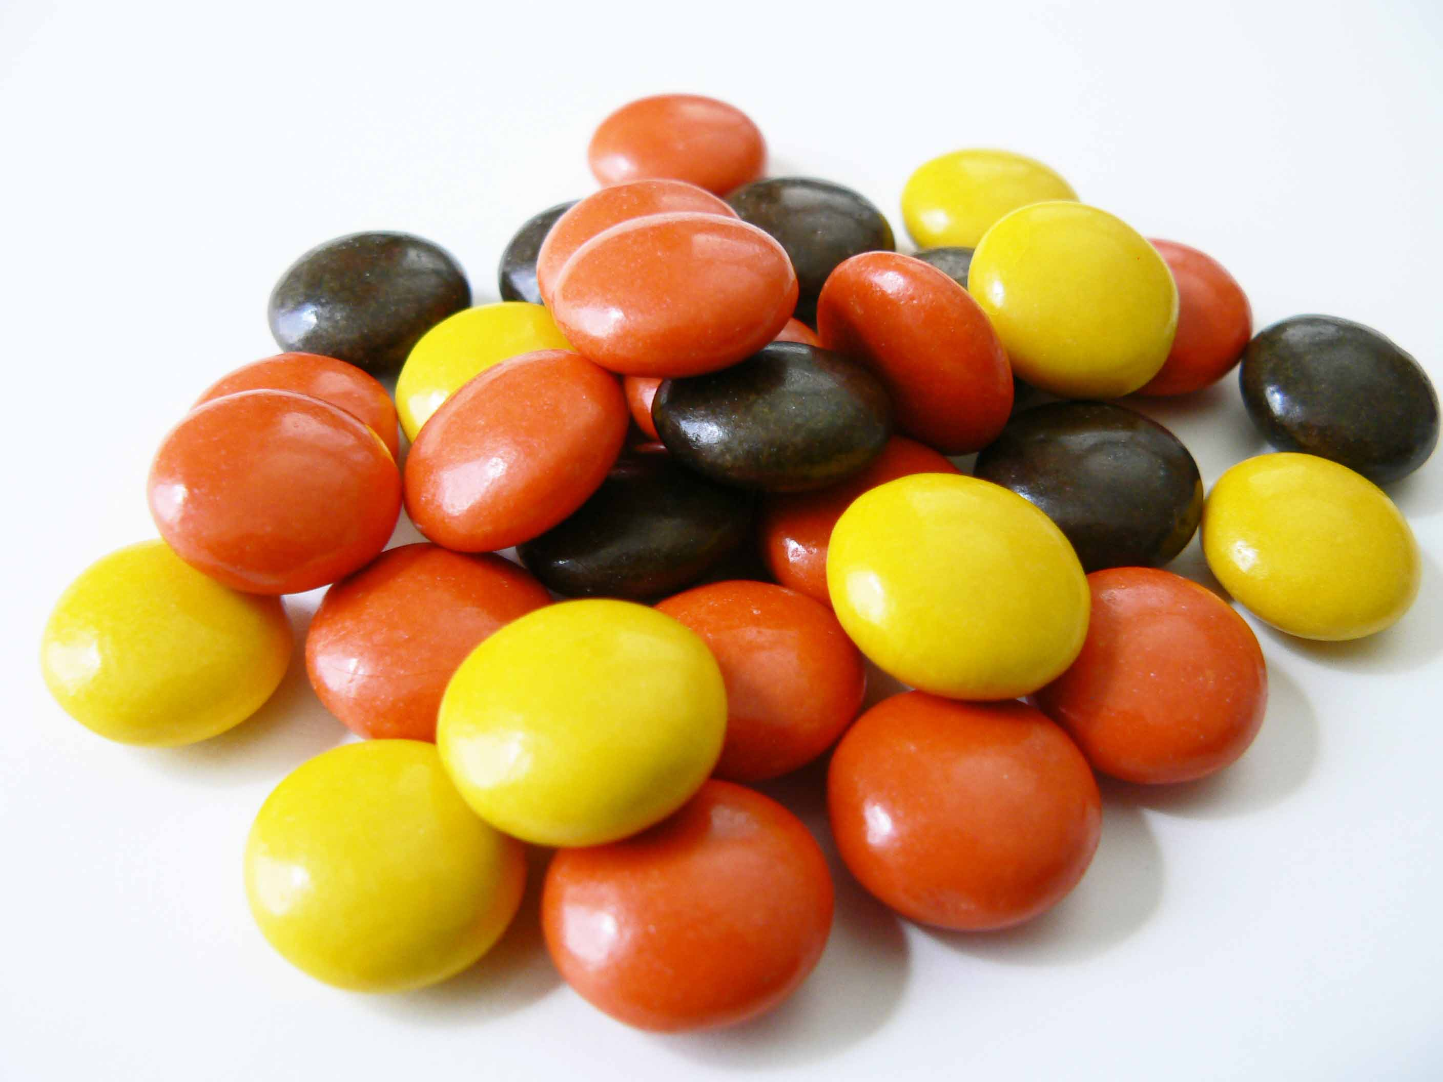
Recognize your state of being justified
You were Sanctified
Sanctified means: Set apart
Set Apart

Slide 8
Recognize your state of being justified
You were Justified
Justified means: Declared or made righteous in the sight of God
Putting it all together:
When you are washed in the waters of baptism you are cleansed from sin
When you are free of sin you are sanctified, consecrated to holiness, different from the world, separated from sin
When you are washed and sanctified then you are justified, righteous in the sight of God
In the name of the Lord Jesus Christ
and by the Spirit of God you are
Holy as God is Holy – 1 Peter 1:16

Slide 9
Do not become part of the world again
If we take our holy vessel, our body, and use it for sin:
We are no longer sanctified
We are defiled
We are no longer justified
Or do you not
know that the
unrighteous will
not inherit the
kingdom of God?

Slide 10
Serve God as your master
We do not own our body
We were bought at a price
We must glorify God in our body
We are not to be selfish, focusing on self-gratification
Our body is to remain sanctified, separate from the world, never defiled

Slide 11
Incorrect applications
not
Once washed, sanctified and justified you will be miraculously rewired, fixed
Once washed, sanctified and justified you do not have to work to remain justified
I was washed, I was sanctified and justified, but now I’ve sinned…it’s hopeless
Forgivable!
If we confess our sins, he is faithful and just to forgive us our sins and to cleanse us from all unrighteousness. – 1 John 1:9

Slide 12
Come unto me, all who labor and are heavy laden, and I will give you rest.
Matthew 11:28

