Slide 1
WHO DO I FOLLOW?

Slide 2
WHO DO I FOLLOW?
Good Examples

Slide 3
WHO DO I FOLLOW?
Good Examples | Bad Examples

Slide 4
WHO DO I FOLLOW?
Good Examples | Bad Examples
Joshua (Joshua 24:14-24)

Slide 5
WHO DO I FOLLOW?
Good Examples | Bad Examples
Joshua (Joshua 24:14-24) | Rich Young Ruler (Mark 10:17-22)

Slide 6
WHO DO I FOLLOW?
Good Examples | Bad Examples
Joshua (Joshua 24:14-24) | Rich Young Ruler (Mark 10:17-22)
Job (Job 42:7-8)

Slide 7
WHO DO I FOLLOW?
Good Examples | Bad Examples
Joshua (Joshua 24:14-24) | Rich Young Ruler (Mark 10:17-22)
Job (Job 42:7-8) | Pharisees (Luke 7:29-30)

Slide 8
WHO DO I FOLLOW?
Good Examples | Bad Examples
Joshua (Joshua 24:14-24) | Rich Young Ruler (Mark 10:17-22)
Job (Job 42:7-8) | Pharisees (Luke 7:29-30)
Apostles (John 6:60-69, Acts 4:18-31, 5:28-32)

Slide 9
WHO DO I FOLLOW?
Good Examples | Bad Examples
Joshua (Joshua 24:14-24) | Rich Young Ruler (Mark 10:17-22)
Job (Job 42:7-8) | Pharisees (Luke 7:29-30)
Apostles (John 6:60-69, Acts 4:18-31, 5:28-32) | Herod Agrippa (Acts 26:27-29)

Slide 10
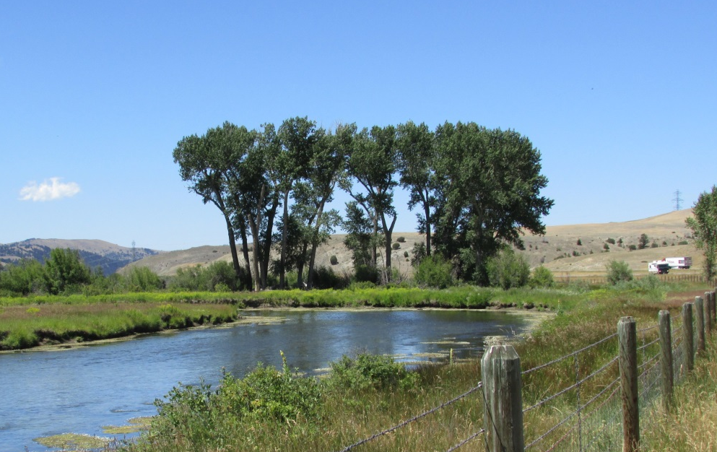
Like a tree planted by the water (Psalm 1:3, Jeremiah 17:7-8)

Slide 11
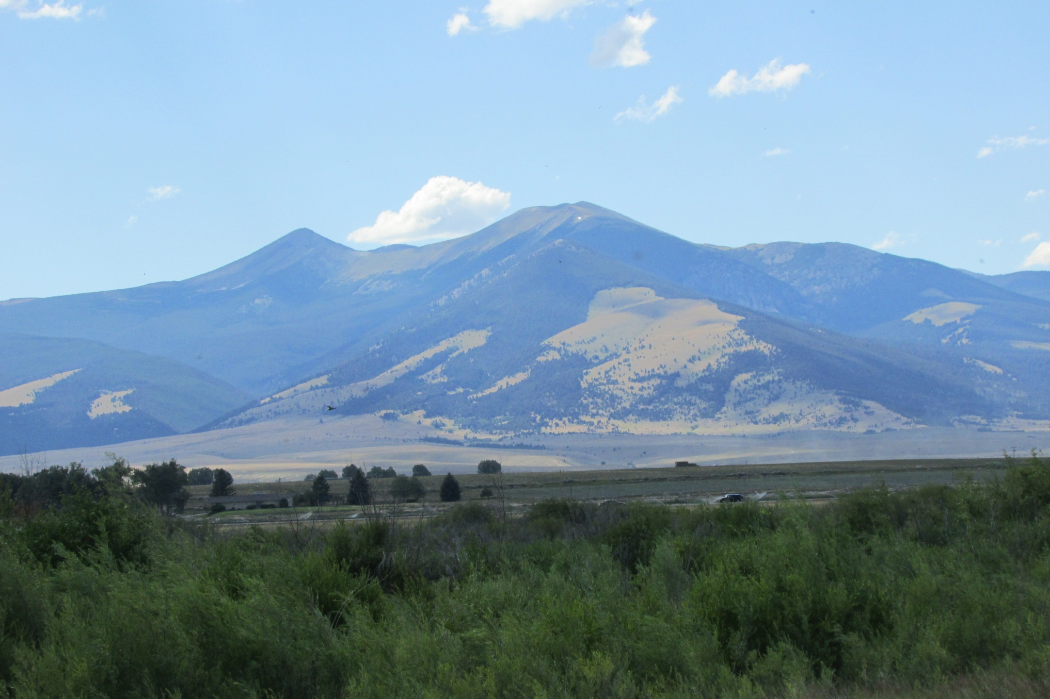

Slide 12
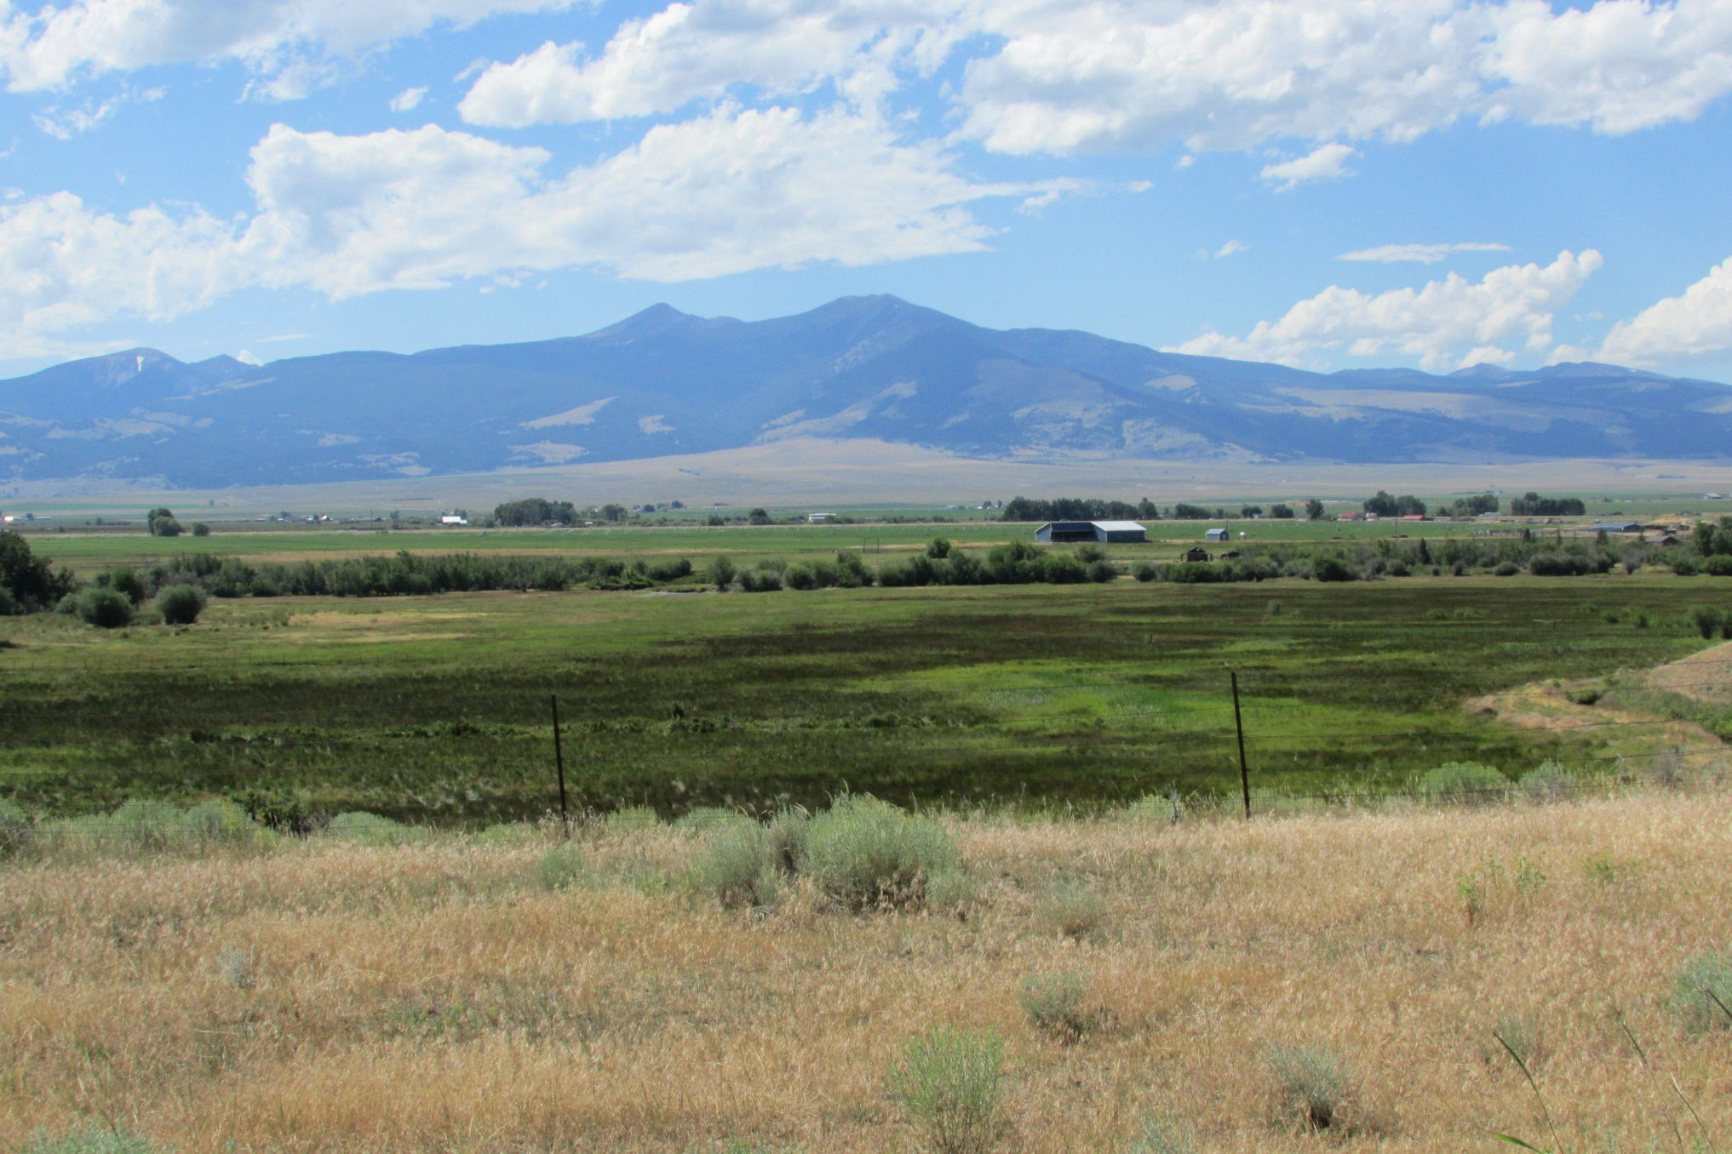

Slide 15
Also see Matthew 8:18-22, John 10:27, Revelation 14:4-5

Slide 16
WHO DO I FOLLOW?
Who Do I Follow Each Day? (Proverbs 3:5-6)
If you are not a Christian, who do you follow? (Galatians 3:26-29)

