Slide 1
21st Century Christianity
Finding Your Church/Life Balance

Slide 2
21st Century Priorities
Children
Family
Careers
Food
Music
Sports
Travel
Games
Exercise
Spirituality

Slide 3
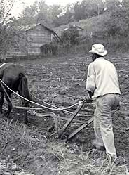
Christianity is Demanding
Luke 9:57-62
Christianity touches every part of our lives
Others will see Jesus in our employment, in our family, in our hobbies and in our relationships
But not every part of our life deserves our primary focus
Our comfort level changes
Our family relationship changes
Our commitments change

Slide 4
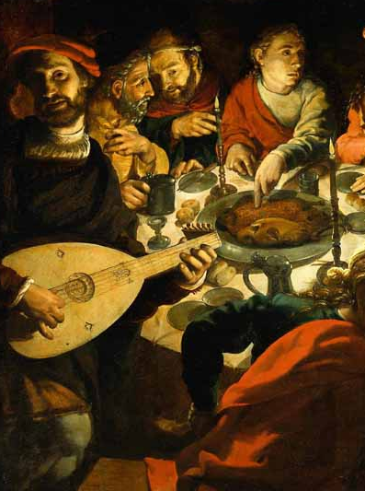
Christianity takes Priority
Amos 6:1-7
Reading this text sounds like a normal day in America!
God expects us to have our clear focus on Spiritual things
Matthew 13:18-23
The world is full of blessings, but they can turn into curses without the proper priority
Our purpose is to bear fruit in this life, and worldly things choke it out

Slide 5
Whose House Is The Cleanest?
Haggai 1:1-15
God knows how your house looks!
When we think of what needs work, do we think about what is most important?
You can have both things done, but which one needs done first
It takes FAITH to leave something in your life undone, but God rewards the faithful
Ask your children what is the more important – your house or God’s house

Slide 6
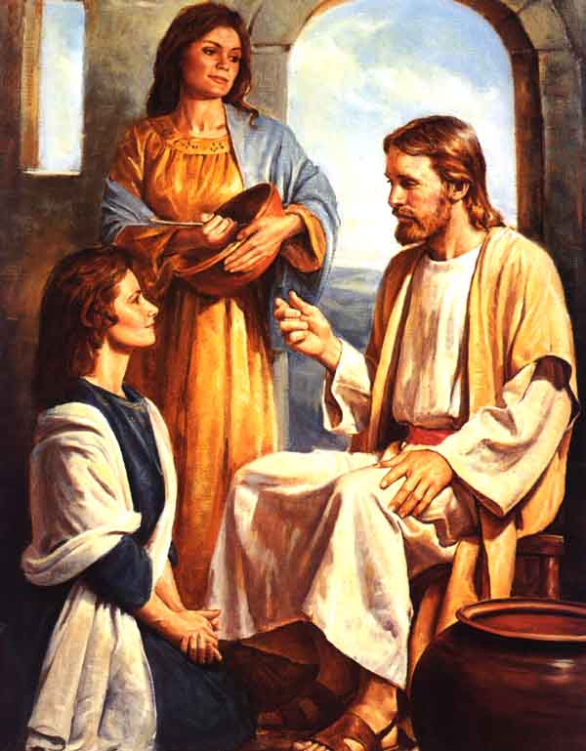
What Food Is More Important?
Luke 10:38-42
Neither thing that each woman is doing is wrong
God just calls us to choose the best part
John 4:8, 31-35
Spiritual priorities always have a cost – you can’t be doing both
We have a finite amount of time to focus on the things of God
Which is more important – sitting at the feet of Jesus or domestic life?

Slide 7
Finding Your Role
Ephesians 4:11-14; Acts 6:2
The good news is you don’t have to do everything
You just have to be a champion for what God has given you to do
Romans 12:6-8
Serve with all your might according to the grace given to you
Roles and strengths will change over time – so will your responsibilities

Slide 8
Finding Your Balance
Plan your week to include time for the things of God
Prioritize spiritual things ahead of everything else
Pray every day (if you are not already doing so)

