Slide 1
Revenge
Another Root of All Kinds of Evil…

Slide 2
What Motivates People to Do Evil?
1 Jn. 2:15-16 – Boils down to Selfishness, which includes greed and revenge.
Consider fictional villains & their motives
Michael Corleone, The Godfather
Inigo Montoya, The Princess Bride

Slide 3
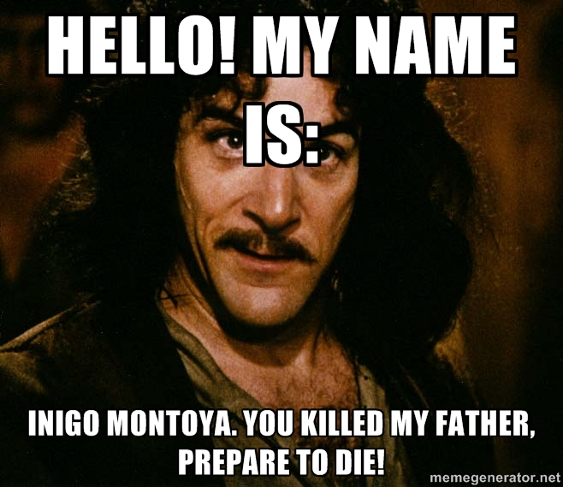

Slide 4
Biblical Examples of Personal Revenge
Lamech – Gen. 4:23-24
Simeon & Levi avenging their sister’s rape – Gen. 34
James & John ask to command fire from heaven – Lk. 9:52-56

Slide 5
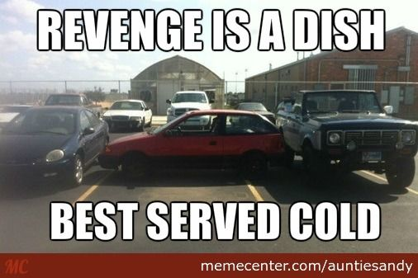
Revenge is Not for the Christian
Heb. 10:30 – “Vengeance is Mine.”
Mt. 5:38-45 – Turn the other cheek…

Slide 6
Application: Don’t Seek Revenge in…
Marriage – Col. 3:18-19
Family – Col. 3:20-21
Job – Col. 3:22—4:1
Church – 1 Cor. 12:23-26

Slide 7
Instead of Revenge…
Rom. 12:17 – Take thought for what is noble in the sight of all.
Rom. 12:18 – Live peaceably with all.
Rom. 12:21 – Overcome evil with good.
1 Ths. 5:15 – Always seek to do good to one another and to all.
1 Pet. 3:9 – Repay with a blessing. It is for this that you were called—that you might inherit a blessing.

Slide 8
Forgiveness > Revenge
Personal vengeance is not sweet—it’s sin that is connected to other sins (lack of love, gossip, slander, hatred, jealousy, murder, etc.).
Jesus demonstrated opposite of revenge.
Lk. 22:49-51, Jn. 18:10-11 – Healed Malchus’ ear
Lk. 23:34 – “Forgive them.”

