Slide 1
In The ONE Thing, you’ll learn to:
Cut through the clutter
Achieve better results in less time
Build momentum toward your goal
Dial down the stress
Overcome that overwhelmed feeling
Revive your energy
Stay on track
Master what matters to you
(copied from the front flap)
Notes:
Gary Keller is chairman of the board and cofounder of Keller Williams Reality, Inc. which holds the #1 position as the largest real estate company in the United States. His New Your times bestselling books have sold more than 1,300,000 copies.

Slide 2
?
WHAT’S YOUR
ONE
THING?
reproduced from image on back cover
Notes:
There are several techniques presenting in the book, but the first is exceedingly simple – what is the one thing?
Boil it all down to one thing – what is it?

Slide 3
Jesus Christ
Jesus Christ – John 14:6 (Hebrews)
Christian
Scriptural – Acts 11:26
It is who we are
Name on the building
Scriptural – Romans 16:16
Focus – Mark 7:1-11
Our ONE thing is Jesus Christ, now what?

Slide 4
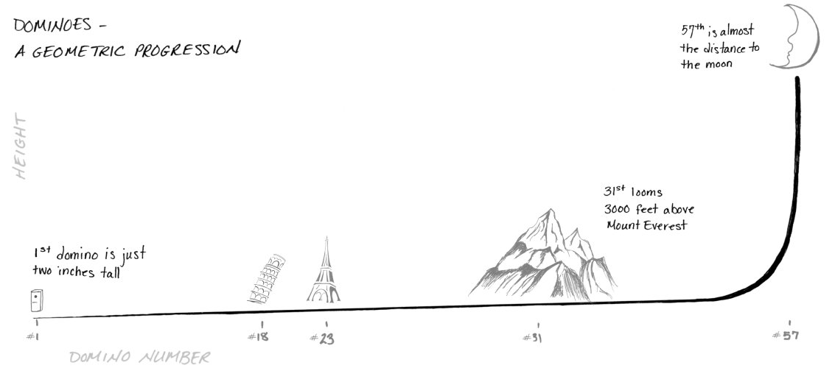
Start small to go
BIG
The ONE Thing, Figure 2, pp. 14-15
Notes:
In 1983, Lorne Whitehead of British Columbia set up a domino amplifier, with each domino 1.5 times larger in size than the previous domino.
One of the most common and most STUPID things I think all off us do, is see someone successful and want that success right away.
In business we understand to amass a client base or a portfolio of properties it takes time and effort, why do we not see that in service to God?

Slide 5
Start small to go
BIG
Start Here
Not Here

Slide 6
Jesus, The Way
Jesus experienced what we experience (Hebrews 4:15)
Sadness (John 11)
Troubled (Matthew 26:36-46)
Joy (Matthew 3:13-17; Mark 9:1-8)
Trials (Matthew 4:1-11)
Disappointment (Mark 9, Matthew 14)
Jesus is the Way to:
A better life (John 10:10)
Forgiveness of sins (Ephesians 1:7)
Unity (John 17:20-23)
God and Eternal Life (John 14:6;17:1-3)

Slide 7
Seeing the BIG PICTURE
Bible:
Collection of 66 books – 39OT/27NT
Over 40 authors
Written over 1500 years
One theme – God’s Plan of Redemption
Anchored by the writing of OT
Fulfilled in NT - “the gospel”
ONE Gospel
Jesus last words (Mark 16:15)
Power of Salvation (Romans 1:16)
Power to Condemn (2 Thessalonians 1:7-8)
Change = Different Gospel (Galatians 1:6-9)
Eternal Plan – Salvation! (John 3:16, Eph 3:11; 1:3-6)…

