Slide 1
THE TEMPLE OF GOD
The House of The Lord
(Psalm 23:6)

Slide 2
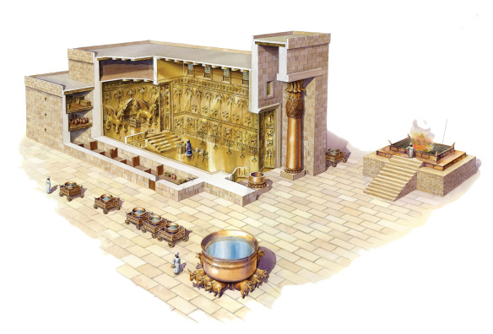
THE ISRAELITE TEMPLE OF GOD

Slide 3
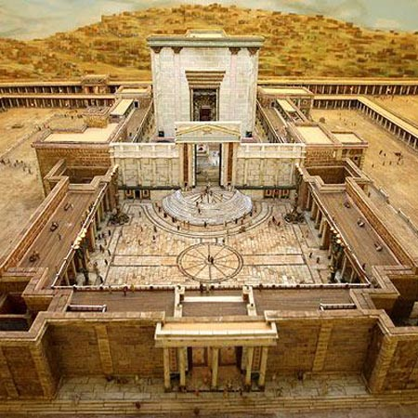
THE ISRAELITE TEMPLE OF GOD

Slide 4
The Israelite Temple of God

Slide 5
The Israelite Temple of God
Built by Solomon, where the presence of God was (1 Kings 5:3, 6:11-12)

Slide 6
The Israelite Temple of God
Built by Solomon, where the presence of God was (1 Kings 5:3, 6:11-12)
Dedicated by Solomon (1 Kings 8:22-27, 2 Chronicles 7:1-3)

Slide 7
The Israelite Temple of God
Built by Solomon, where the presence of God was (1 Kings 5:3, 6:11-12)
Dedicated by Solomon (1 Kings 8:22-27, 2 Chronicles 7:1-3)
Would be destroyed and end worship there (Mark 14:58, 15:38, John 4:21-24)

Slide 8
The New Testament Temple of God

Slide 9
The New Testament Temple of God
Circumcision is now of the heart (Ro. 2:28-29)

Slide 10
The New Testament Temple of God
Circumcision is now of the heart (Ro. 2:28-29)
Christians are now the Temple of God and to be kept holy (1 Corinthians 3:16-17, 6:19-20)

Slide 11
The New Testament Temple of God
Circumcision is now of the heart (Ro. 2:28-29)
Christians are now the Temple of God and to be kept holy (1 Corinthians 3:16-17, 6:19-20)
God dwells in the Christian Temple of God (2 Corinthians 6:16, 1 Timothy 3:15)

Slide 12
The New Testament Temple of God
Circumcision is now of the heart (Ro. 2:28-29)
Christians are now the Temple of God and to be kept holy (1 Corinthians 3:16-17, 6:19-20)
God dwells in the Christian Temple of God (2 Corinthians 6:16, 1 Timothy 3:15)
This Temple of God is built on the foundation of the prophets and apostles, with Christ as Chief cornerstone (Ephesians 2:19-22)

Slide 13
The New Testament Temple of God
Circumcision is now of the heart (Ro. 2:28-29)
Christians are now the Temple of God and to be kept holy (1 Corinthians 3:16-17, 6:19-20)
God dwells in the Christian Temple of God (2 Corinthians 6:16, 1 Timothy 3:15)
This Temple of God is built on the foundation of the prophets and apostles, with Christ as Chief cornerstone (Ephesians 2:19-22)
We Christians (priests, Temple of God) are to offer spiritual sacrifices (1 Peter 2:4-5, 9-10)

Slide 14
The Everlasting Temple of God

Slide 15
The Everlasting Temple of God
This is where God is (2 Samuel 22:7)

Slide 16
The Everlasting Temple of God
This is where God is (2 Samuel 22:7)
Jesus (the Lamb) is greater than any physical temple (Matthew 12:6)

Slide 17
The Everlasting Temple of God
This is where God is (2 Samuel 22:7)
Jesus (the Lamb) is greater than any physical temple (Matthew 12:6)
The Throne of God and The Lamb are to be in New Jerusalem; the Heavenly Temple of God (Revelation 3:12, 7:15-17, 21:1-8, 21:22-22:5)

Slide 18
For the Christians here this morning:

Slide 19
For the Christians here this morning:
Can you look in the mirror and say you are living your life as a Temple of God? (2 Cor. 13:5, James 1:23-27)

Slide 20
For the Christians here this morning:
Are we keeping ourselves pure, offering spiritual sacrifices each day for the Lord, and shining the Light of Jesus as one of His sanctified priests?

Slide 21
For those who are not Christians:

Slide 22
For those who are not Christians:
Why not become a Temple of God (a Christian) today? There is no other way but His way (John 14:6, 15).

Slide 23
For those who are not Christians:
Humbly submit to the Lord’s commands (1 John 3:22-24, 5:1-5).

Slide 24
For those who are not Christians:
Humbly submit to the Lord’s commands (1 John 3:22-24, 5:1-5).
Repent of your sins and be baptized to wash them all away (Acts 2:38).

Slide 25
For those who are not Christians:
Humbly submit to the Lord’s commands (1 John 3:22-24, 5:1-5).
Repent of your sins and be baptized to wash them all away (Acts 2:38).
Leave this physical building today as a spiritual temple of God!

Slide 26
A Christian is an individual that one day will be taken to the everlasting Temple of God and Christ. We Christians need to live our lives each moment as a Temple of God, in a way that brings glory to God. If we defile our Temple in any way without forgiveness, we will never live in the Heavenly Temple of God.

Slide 27
If we can help you now, please come forward as we stand and sing!

