Slide 1
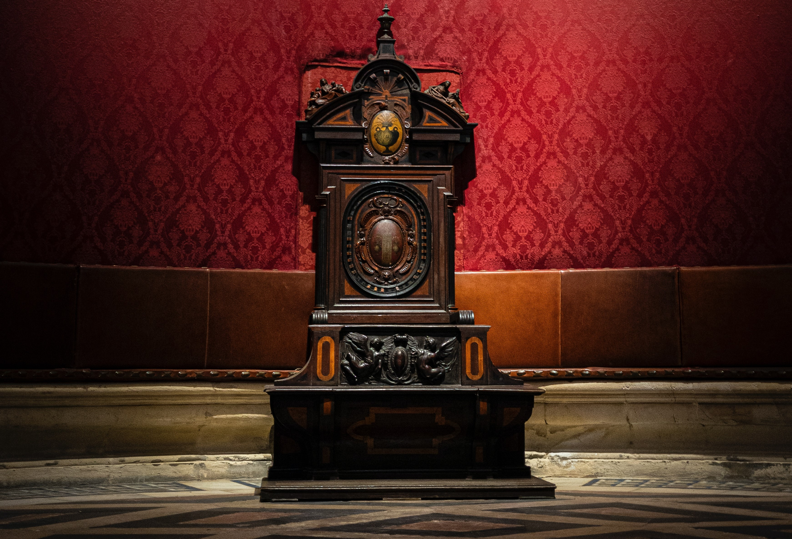
Revelation Overview
Discovering God through Revelation

Slide 2
Background Information
Purpose
Message
To encourage and comfort afflicted Christians through trials.
There is guaranteed victory in Jesus over evil.

Slide 3
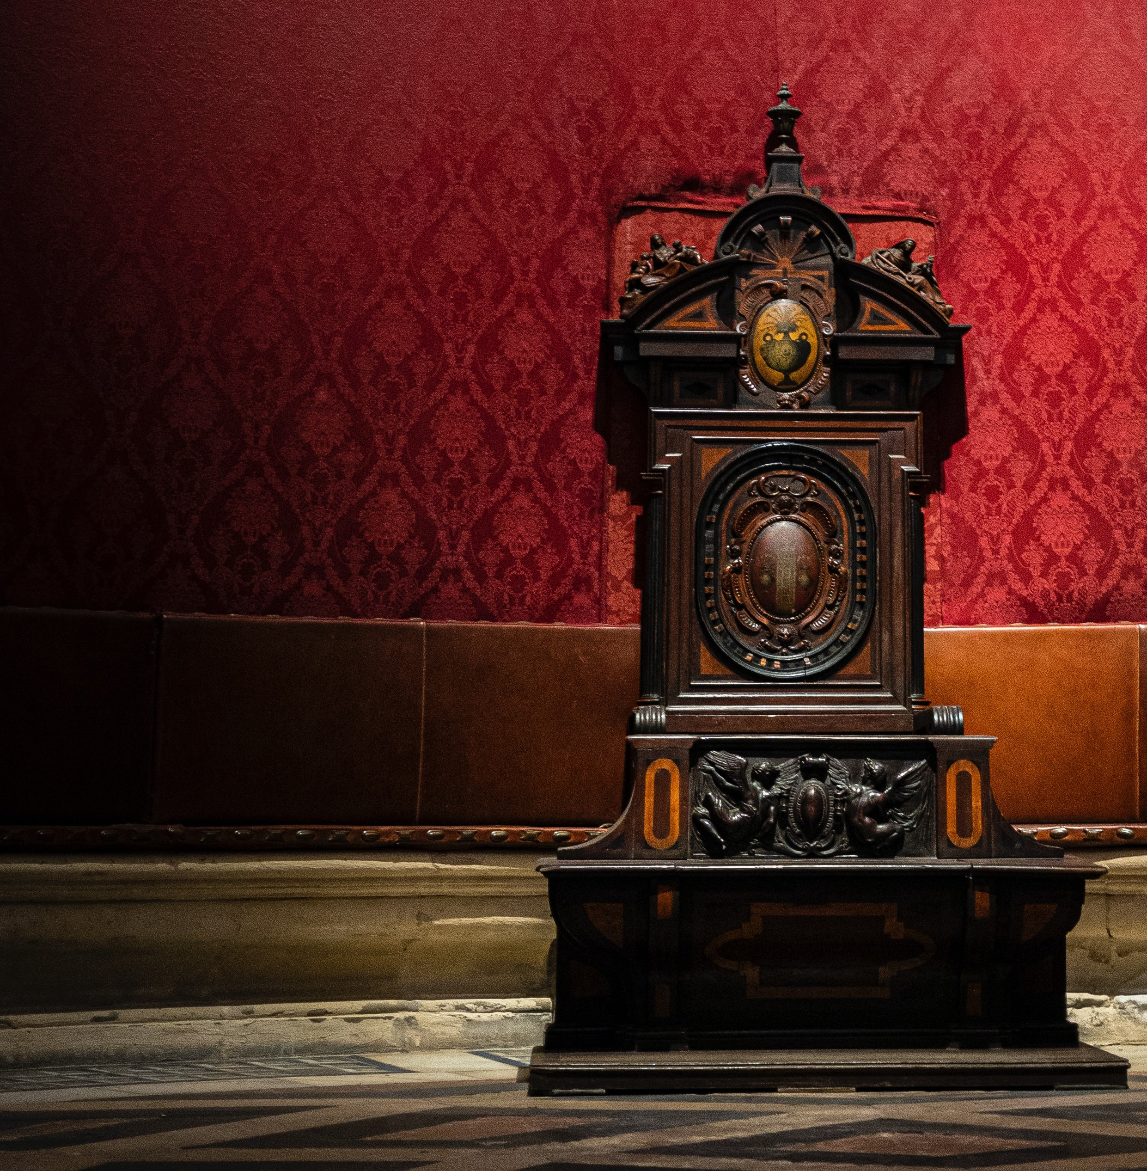
Background Information
Theme- Jesus wins the struggle
Team God
Father
Son Spirit
Followers: Israel, Bride
Team Satan
Devil
False
Beast Prophet
Followers: Babylon, Harlot
Theme- Overcome Persecution

Slide 4
Overview Outline
Introduction (1-3)
  Greeting (1:1-7)
  Vision of Jesus- Hero (1:8-20)
  Letters to the 7 churches (2-3)
Vision of John (4-22:6)
  Setting: Heavenly Throne (4-5)
  Seven Seals: Judgment 1 (6-8:5)
  Seven Trumpets: Judgment 2 (8:6-11:19)
  Struggle: Reason for Judgment (12-14)
  Seven Bowls: Judgment 3 (15-16)
  Supplanting God’s enemies: Punishment (17-20)
  Significant Event: New Heaven and Earth (21-22:6)
Conclusion (22:7-21)
  Blessing (22:7-11)
  Reward (22:12-15)
  Invite (22:16-21)

Slide 5
Overview Outline
Introduction (1-3)
  Greeting (1:1-7)
  Vision of Jesus- Hero (1:8-20)
  Letters to the 7 churches (2-3)
Letter Structure
Address
Attribute
Approval
Accusation
Advice
Appeal
Assurance

Slide 6
Overview Outline
Vision of John (4-22:6)
  Setting: Heavenly Throne (4-5)

Slide 7
Overview Outline
Vision of John (4-22:6)
  Setting: Heavenly Throne (4-5)
  Seven Seals: Judgment 1 (6-8:5) {sequence 4-2-1}
    Six Seals opened (6)
    Interlude: Protection of God’s People (7)
    Seventh Seal opened (8:1-5) {3 key events}
White horse-1 | Red horse-2 | Black horse-3 | Green Horse-4
Martyred Saints-5 | Fallen Skies-6
Silence in heaven | 7 Angels | Golden Censer

Slide 8
Overview Outline
Vision of John (4-22:6)
  Setting: Heavenly Throne (4-5)
  Seven Seals: Judgment 1 (6-8:5)
  Seven Trumpets: Judgment 2 (8:6-11:19)
    Six Trumpets (8-9)
    Interlude: God’s Witnesses (10-11)
    Seventh Trumpet (11:1-19)
1/3rd Burned-1 | 1/3rd sea of blood-2 | 1/3rd of rivers-3 | 1/3rd of the sky-4
Great Abyss- Locusts- 5 | Great Army of Woe-6
Victory Declared | Praise God | Natural Disasters

Slide 9
Overview Outline
Vision of John (4-22:6)
  Setting: Heavenly Throne (4-5)
  Seven Seals: Judgment 1 (6-8:5)
  Seven Trumpets: Judgment 2 (8:6-11:19)
  Struggle: Reason for Judgment (12-14)
    Birth (12:1-6) / War (12:7-17)
    Forces of Satan (13) / Forces of God (14)

Slide 10
Overview Outline
Vision of John (4-22:6)
  Setting: Heavenly Throne (4-5)
  Seven Seals: Judgment 1 (6-8:5)
  Seven Trumpets: Judgment 2 (8:6-11:19)
  Struggle: Reason for Judgment (12-14)
  Seven Bowls: Judgment 3 (15-16)
    Final Judgment Preparation (15)
    Seven Bowls of Wrath (16)
Sores-1 | Sea of blood-2 | Rivers of blood-3 | Sun-4
Throne of beast- 5 | Great River-6
Proclamation /Great Natural Disaster /Babylon destroyed-7

Slide 11
Overview Outline
Vision of John (4-22:6)
  Setting: Heavenly Throne (4-5)
  Seven Seals: Judgment 1 (6-8:5)
  Seven Trumpets: Judgment 2 (8:6-11:19)
  Struggle: Reason for Judgment (12-14)
  Seven Bowls: Judgment 3 (15-16)
  Supplanting God’s enemies: Punishment (17-20)
    Babylon (17-18)
    Beast & False Prophet (19)
    Satan (20)

Slide 12
Overview Outline
Vision of John (4-22:6)
  Setting: Heavenly Throne (4-5)
  Seven Seals: Judgment 1 (6-8:5)
  Seven Trumpets: Judgment 2 (8:6-11:19)
  Struggle: Reason for Judgment (12-14)
  Seven Bowls: Judgment 3 (15-16)
  Supplanting God’s enemies: Punishment (17-20)
  Significant Event: New Heaven and Earth (21-22:6)
    God dwells among his people again (21:1-4)
    God gives inheritance (21:5-8)
    God makes a new Holy City (21:9-27)
    God gives eternal life to his people (22:1-6)

Slide 13
Overview Outline
Conclusion (22:7-21)
  Blessing (22:7-11)
  Reward (22:12-15)
  Invite (22:16-21)
Application
Watch out for Satan's deception. (Rev. 13:3-4)
We can overcome. (Rev. 14:12-13)
Invite all to come to the wedding feast! (Rev. 22:16-17)

Slide 14
Revelation Overview
Discovering God through Revelation

