Slide 1
Seeking
&
Saving
the
LOST
Luke 19:10
By David Dann

Slide 2
Seeking & Saving the LOST

Slide 3
Seeking & Saving the LOST
Jesus came into the world to save the lost.

Slide 4
Seeking & Saving the LOST
Luke 19:10
10 "...for the Son of Man has come to seek and to save that which was lost."

Slide 5
Seeking & Saving the LOST
1 Timothy 1:15
15 This is a faithful saying and worthy of all acceptance, that Christ Jesus came into the world to save sinners, of whom I am chief.

Slide 6
Seeking & Saving the LOST
Jesus came into the world to save the lost.

Slide 7
Seeking & Saving the LOST
Jesus came into the world to save the lost.
Jesus commanded His followers to reach & teach the lost.

Slide 8
Seeking & Saving the LOST
Matthew 28:19-20
19 "Go therefore and make disciples of all the nations, baptizing them in the name of the Father and of the Son and of the Holy Spirit,
20 "teaching them to observe all things that I have commanded you; and lo, I am with you always, even to the end of the age." Amen.

Slide 9
Seeking & Saving the LOST
Mark 16:15-16
15 And He said to them, "Go into all the world and preach the gospel to every creature.
16 "He who believes and is baptized will be saved; but he who does not believe will be condemned."

Slide 10
Seeking & Saving the LOST
Jesus came into the world to save the lost.
Jesus commanded His followers to reach & teach the lost.

Slide 11
Seeking & Saving the LOST
Jesus came into the world to save the lost.
Jesus commanded His followers to reach & teach the lost.
We need to bring lost souls to Christ!

Slide 12
Seeking & Saving the LOST
Isaiah 59:1-2
1 Behold, the LORD's hand is not shortened, That it cannot save; Nor His ear heavy, That it cannot hear.
2 But your iniquities have separated you from your God; And your sins have hidden His face from you, So that He will not hear.

Slide 13
Seeking & Saving the LOST
2 Thessalonians 1:6-8
6 …since it is a righteous thing with God to repay with tribulation those who trouble you,
7 and to give you who are troubled rest with us when the Lord Jesus is revealed from heaven with His mighty angels,
8 in flaming fire taking vengeance on those who do not know God, and on those who do not obey the gospel of our Lord Jesus Christ.

Slide 14
Seeking & Saving the LOST
HOW?
Jesus came into the world to save the lost.
Jesus commanded His followers to reach & teach the lost.
We need to bring lost souls to Christ!

Slide 15
Seeking & Saving the LOST

Slide 16
Seeking & Saving the LOST
HOW?
Jesus came into the world to save the lost.
Jesus commanded His followers to reach & teach the lost.
We need to bring lost souls to Christ!

Slide 17
Seeking & Saving the LOST

Slide 18
Seeking & Saving the LOST
1
Understand What Is Involved

Slide 19
Seeking & Saving the LOST
1
Understand What Is Involved
The process is simple

Slide 20
Seeking & Saving the LOST
1
Understand What Is Involved
Romans 10:13-14
13 For "whoever calls on the name of the LORD shall be saved."
14 How then shall they call on Him in whom they have not believed? And how shall they believe in Him of whom they have not heard? And how shall they hear without a preacher?
15 And how shall they preach unless they are sent? As it is written: "How beautiful are the feet of those who preach the gospel of peace, Who bring glad tidings of good things!"
16 But they have not all obeyed the gospel. For Isaiah says, "Lord, who has believed our report?"
17 So then faith comes by hearing, and hearing by the word of God.
The process is simple

Slide 21
Seeking & Saving the LOST
1
Understand What Is Involved
Romans 10:17
17 So then faith comes by hearing, and hearing by the word of God.
The process is simple

Slide 22
Seeking & Saving the LOST
1
Understand What Is Involved
2 Timothy 2:2
2 And the things that you have heard from me among many witnesses, commit these to faithful men who will be able to teach others also.
The process is simple

Slide 23
Seeking & Saving the LOST
1
Understand What Is Involved
1 Corinthians 3:6
6 I planted, Apollos watered, but God gave the increase.
The process is simple

Slide 24
Seeking & Saving the LOST
1
Understand What Is Involved
Understand what is NOT involved

Slide 25
Seeking & Saving the LOST
1
Understand What Is Involved
Gimmicks & carnal appeals.
Arguing “religion.”
Sitting & doing nothing.
Understand what is NOT involved

Slide 26
Seeking & Saving the LOST
1
Understand What Is Involved

Slide 27
Seeking & Saving the LOST

Slide 28
Seeking & Saving the LOST
2
Develop The Proper Attitude

Slide 29
Seeking & Saving the LOST
2
Develop The Proper Attitude
Learn to see people like Jesus did

Slide 30
Seeking & Saving the LOST
2
Develop The Proper Attitude
Mark 6:34
34 And Jesus, when He came out, saw a great multitude and was moved with compassion for them, because they were like sheep not having a shepherd. So He began to teach them many things.
Learn to see people like Jesus did

Slide 31
Seeking & Saving the LOST
2
Develop The Proper Attitude
Matthew 7:12
12 "Therefore, whatever you want men to do to you, do also to them, for this is the Law and the Prophets."
Learn to see people like Jesus did

Slide 32
Seeking & Saving the LOST
2
Develop The Proper Attitude
Know that not all who hear will obey

Slide 33
Seeking & Saving the LOST
2
Develop The Proper Attitude
Matthew 13:3-4
3 Then He spoke many things to them in parables, saying: "Behold, a sower went out to sow.
4 "And as he sowed, some seed fell by the wayside; and the birds came and devoured them."
Know that not all who hear will obey

Slide 34
Seeking & Saving the LOST
2
Develop The Proper Attitude
Matthew 13:5-6
5 "Some fell on stony places, where they did not have much earth; and they immediately sprang up because they had no depth of earth.
6 "But when the sun was up they were scorched, and because they had no root they withered away.
Know that not all who hear will obey

Slide 35
Seeking & Saving the LOST
2
Develop The Proper Attitude
Matthew 13:7-8
7 "And some fell among thorns, and the thorns sprang up and choked them.
8 "But others fell on good ground and yielded a crop: some a hundredfold, some sixty, some thirty."
Know that not all who hear will obey

Slide 36
Seeking & Saving the LOST
2
Develop The Proper Attitude

Slide 37
Seeking & Saving the LOST

Slide 38
Seeking & Saving the LOST
3
Open Your Eyes To Opportunities

Slide 39
Seeking & Saving the LOST
3
Open Your Eyes To Opportunities
Opportunities are everywhere

Slide 40
Seeking & Saving the LOST
3
Open Your Eyes To Opportunities
John 4:35
35 "Do you not say, 'There are still four months and then comes the harvest'? Behold, I say to you, lift up your eyes and look at the fields, for they are already white for harvest!"
Opportunities are everywhere

Slide 41
Seeking & Saving the LOST
3
Open Your Eyes To Opportunities
Luke 10:2
2 Then He said to them, "The harvest truly is great, but the laborers are few; therefore pray the Lord of the harvest to send out laborers into His harvest."
Opportunities are everywhere

Slide 42
Seeking & Saving the LOST
3
Open Your Eyes To Opportunities
What about people we already know?

Slide 43
Seeking & Saving the LOST
3
Open Your Eyes To Opportunities
John 1:35-37
35 Again, the next day, John stood with two of his disciples.
36 And looking at Jesus as He walked, he said, "Behold the Lamb of God!"
37 The two disciples heard him speak, and they followed Jesus.
What about people we already know?

Slide 44
Seeking & Saving the LOST
3
Open Your Eyes To Opportunities
John 1:38
38 Then Jesus turned, and seeing them following, said to them, "What do you seek?" They said to Him, "Rabbi" (which is to say, when translated, Teacher), "where are You staying?"
What about people we already know?

Slide 45
Seeking & Saving the LOST
3
Open Your Eyes To Opportunities
John 1:39-40
39 He said to them, "Come and see." They came and saw where He was staying, and remained with Him that day (now it was about the tenth hour).
40 One of the two who heard John speak, and followed Him, was Andrew, Simon Peter's brother.
What about people we already know?

Slide 46
Seeking & Saving the LOST
3
Open Your Eyes To Opportunities
John 1:41-42
41 He first found his own brother Simon, and said to him, "We have found the Messiah" (which is translated, the Christ).
42 And he brought him to Jesus. Now when Jesus looked at him, He said, "You are Simon the son of Jonah. You shall be called Cephas" (which is translated, A Stone).
What about people we already know?

Slide 47
Seeking & Saving the LOST
“What was responsible for your coming to Christ and this church?”
*Survey by The Institute for American Church Growth.

Slide 48
Seeking & Saving the LOST
“What was responsible for your coming to Christ and this church?”
.5%--I attended a gospel meeting.
1%--I visited there.
2%--I had a special need.
3%--I just walked in.
3%--I liked the programs.
5%--I like the Bible class.
6%--I liked the minister.
75%--A friend or relative invited me.
*Survey by The Institute for American Church Growth.

Slide 49
Seeking & Saving the LOST
“What was responsible for your coming to Christ and this church?”
.5%--I attended a gospel meeting.
1%--I visited there.
2%--I had a special need.
3%--I just walked in.
3%--I liked the programs.
5%--I like the Bible class.
6%--I liked the minister.
75%--A friend or relative invited me.
*Survey by The Institute for American Church Growth.

Slide 50
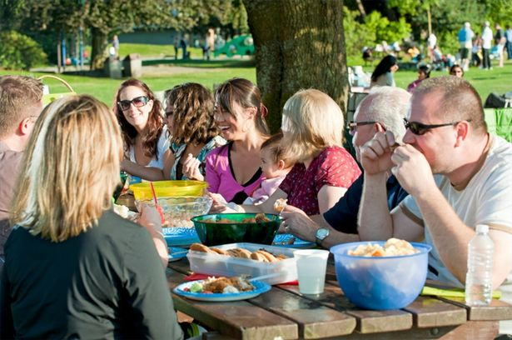
Seeking & Saving the LOST
3
Open Your Eyes To Opportunities
What about people we already know?
Family/Relatives

Slide 51
Seeking & Saving the LOST
3
Open Your Eyes To Opportunities
What about people we already know?
Friends

Slide 52
Seeking & Saving the LOST
3
Open Your Eyes To Opportunities
What about people we already know?
Co-workers

Slide 53
Seeking & Saving the LOST
3
Open Your Eyes To Opportunities
What about people we already know?
Neighbors

Slide 54
Seeking & Saving the LOST
3
Open Your Eyes To Opportunities
What about people we already know?
Fellow Students

Slide 55
Seeking & Saving the LOST
3
Open Your Eyes To Opportunities
What about people we already know?
Grocery Store Clerks

Slide 56
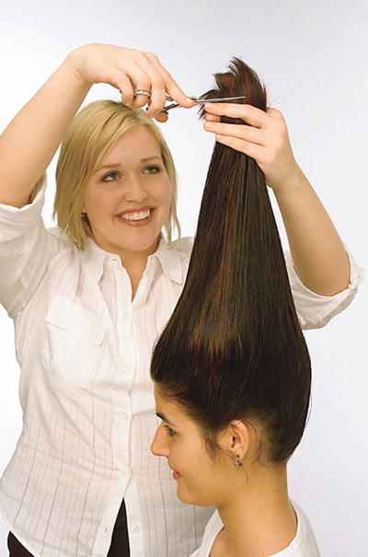
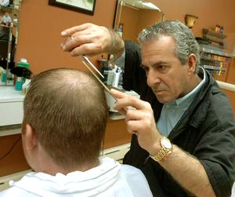
Seeking & Saving the LOST
3
Open Your Eyes To Opportunities
What about people we already know?
Barber/Hair Stylist

Slide 57
Seeking & Saving the LOST
3
Open Your Eyes To Opportunities
What about people we already know?
Teachers

Slide 58
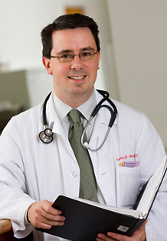
Seeking & Saving the LOST
3
Open Your Eyes To Opportunities
What about people we already know?
Doctor/Dentist

Slide 59
Seeking & Saving the LOST
3
Open Your Eyes To Opportunities
What about people we already know?
Auto Mechanic

Slide 60
Seeking & Saving the LOST
3
Open Your Eyes To Opportunities
What about people we already know?
Pest Control

Slide 61
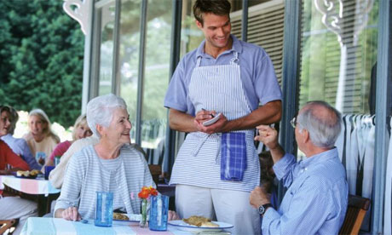
Seeking & Saving the LOST
3
Open Your Eyes To Opportunities
What about people we already know?
Waitress/Waiter

Slide 62
Seeking & Saving the LOST
3
Open Your Eyes To Opportunities
What about people we already know?

Slide 63
Seeking & Saving the LOST
3
Open Your Eyes To Opportunities
What are other ways
to find prospects?

Slide 64
Seeking & Saving the LOST
3
Open Your Eyes To Opportunities
Acts 17:1-2
1 Now when they had passed through Amphipolis and Apollonia, they came to Thessalonica, where there was a synagogue of the Jews.
2 Then Paul, as his custom was, went in to them, and for three Sabbaths reasoned with them from the Scriptures…
What are other ways
to find prospects?

Slide 65
Seeking & Saving the LOST
3
Open Your Eyes To Opportunities
Acts 17:16-17
16 Now while Paul waited for them at Athens, his spirit was provoked within him when he saw that the city was given over to idols.
17 Therefore he reasoned in the synagogue with the Jews and with the Gentile worshipers, and in the marketplace daily with those who happened to be there.
What are other ways
to find prospects?

Slide 66
Seeking & Saving the LOST
3
Open Your Eyes To Opportunities
John 4:6-7
6 Now Jacob's well was there. Jesus therefore, being wearied from His journey, sat thus by the well. It was about the sixth hour.
7 A woman of Samaria came to draw water. Jesus said to her, "Give Me a drink."
What are other ways
to find prospects?

Slide 67
Seeking & Saving the LOST
3
Open Your Eyes To Opportunities
Contacts of prospects.
Visitors to our assemblies.
Door-to-door work.
Those who call the church building.
Ads in paper, radio, television, social media, etc.
Internet.
Set up a booth at a fair/trade-show.
What are other ways
to find prospects?

Slide 68
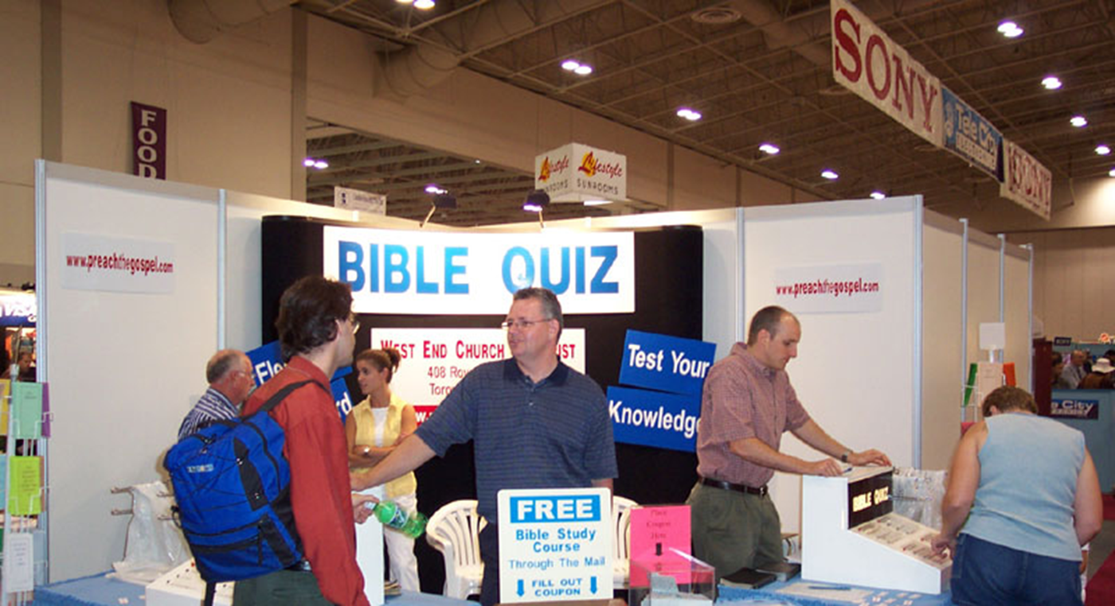
Seeking & Saving the LOST
3
Open Your Eyes To Opportunities
What are other ways
to find prospects?
Fair Booth

Slide 69
Seeking & Saving the LOST
3
Open Your Eyes To Opportunities

Slide 70
Seeking & Saving the LOST

Slide 71
Seeking & Saving the LOST
4
Work The Plan

Slide 72
Seeking & Saving the LOST
4
Work The Plan
Make a list
of people you intend to reach

Slide 73
Seeking & Saving the LOST
4
Work The Plan
Work to bring these people to Christ

Slide 74
Seeking & Saving the LOST
4
Work The Plan
1 Timothy 2:1, 3-4
1 Therefore I exhort first of all that supplications, prayers, intercessions, and giving of thanks be made for all men…
3 …For this is good and acceptable in the sight of God our Savior,
4 who desires all men to be saved and to come to the knowledge of the truth.
Work to bring these people to Christ

Slide 75
Seeking & Saving the LOST
4
Work The Plan
2 Thessalonians 3:1
1 Finally, brethren, pray for us, that the word of the Lord may run swiftly and be glorified, just as it is with you...
Work to bring these people to Christ

Slide 76
Seeking & Saving the LOST
4
Work The Plan
Familiarize yourself with teaching tools

Slide 77
Seeking & Saving the LOST
4
Work The Plan
Romans 10:17
17 So then faith comes by hearing, and hearing by the word of God.
Familiarize yourself with teaching tools

Slide 78
Seeking & Saving the LOST
4
Work The Plan
Get to work!

Slide 79
Seeking & Saving the LOST
4
Work The Plan
Get to work!

Slide 80
Seeking & Saving the LOST
4
Work The Plan

Slide 81
Seeking & Saving the LOST
1
Understand What Is Involved
2
Develop The Proper Attitude
3
Open Your Eyes To Opportunities
4
Work The Plan

Slide 82
Seeking & Saving the LOST
Philippians 4:13
13 I can do all things through Christ who strengthens me.

Slide 83
You can do this!!!

