Slide 1
What Motivated Jesus?

Slide 2
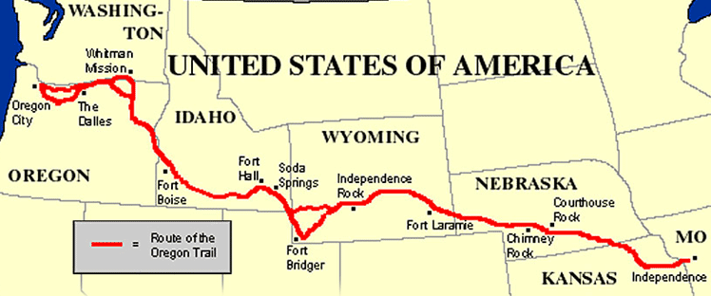
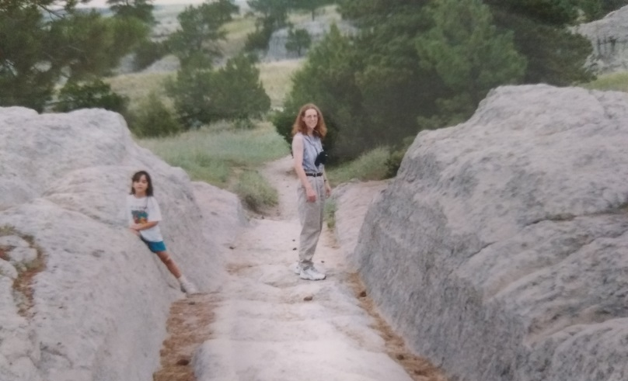
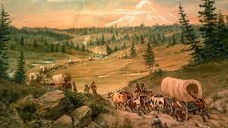
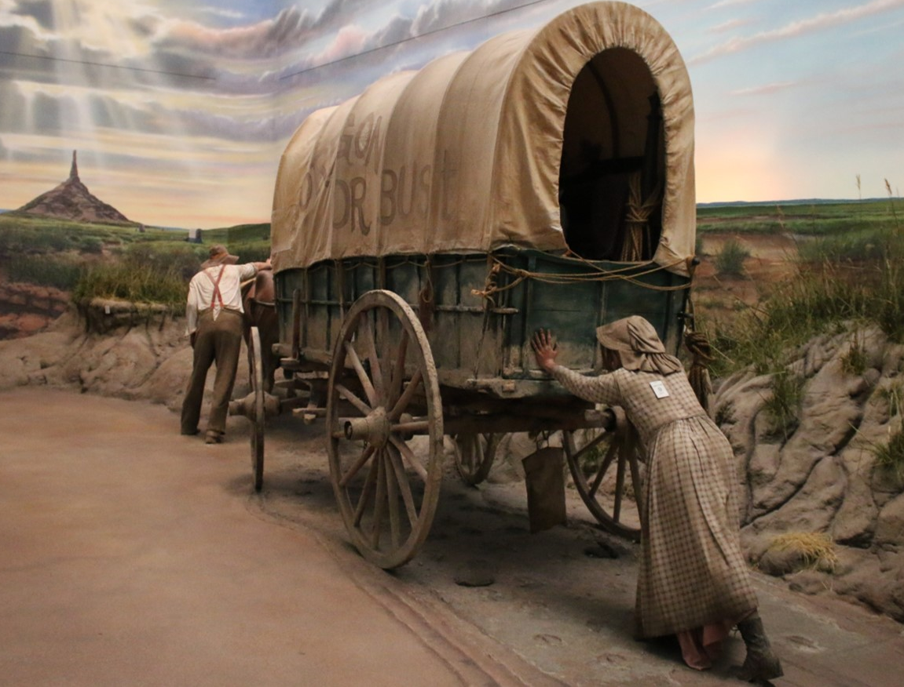
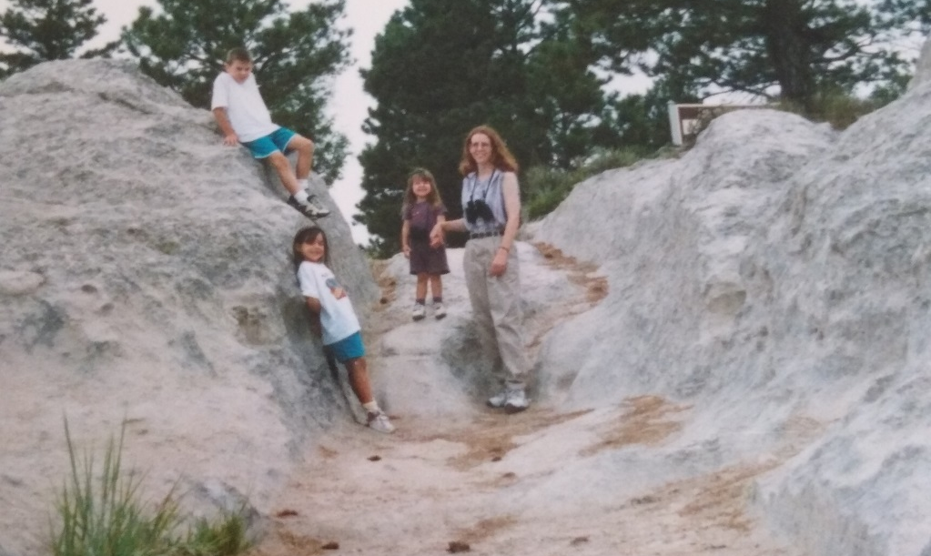

Slide 3
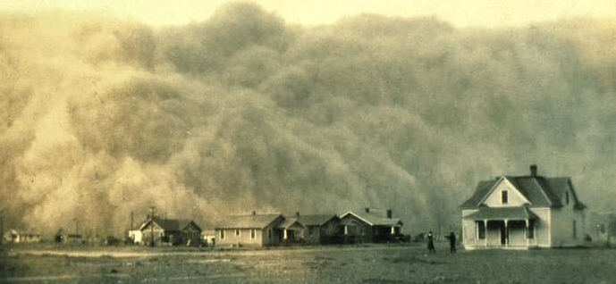
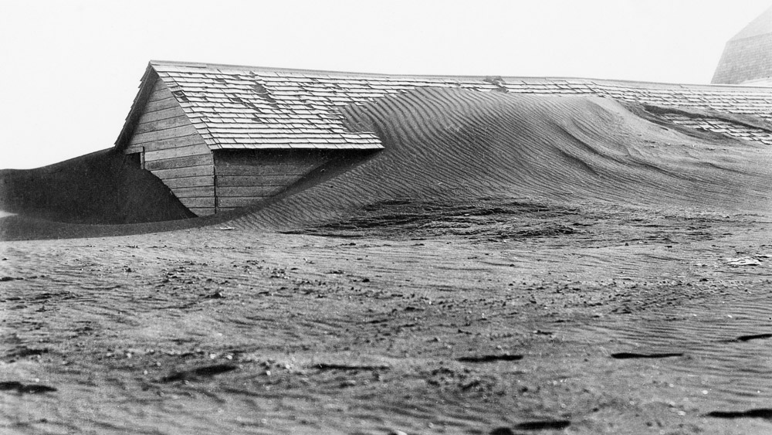
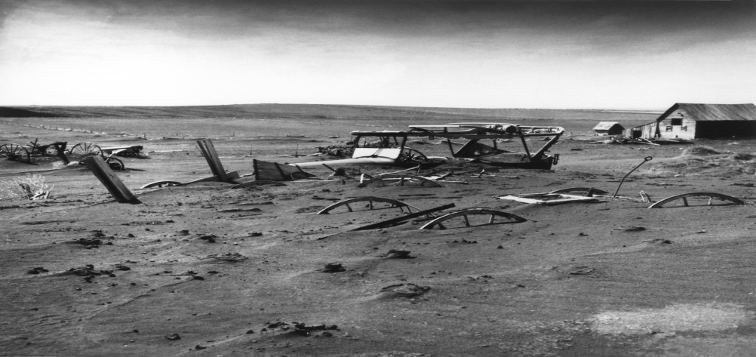

Slide 5
What Motivated Jesus?

Slide 6
What Motivated Jesus?
Pleasing The Father
His Love for All
Victory Over Satan
Heaven

Slide 7
What Motivates You?
Are you pleasing The Father every day?
Are you driven by your love for your neighbor?
Are you winning your battle with Satan?
Are you heading to a better place?

