Slide 1
PUTTING LIMITATIONS ON GOD

Slide 2
LUKE 19:28-40
God is not limited by the laws of this Earth
The Pharisees had no concept of what they asked in vs. 39
The fact that Christ is King is declared by all creation
Matt. 3:9

Slide 3
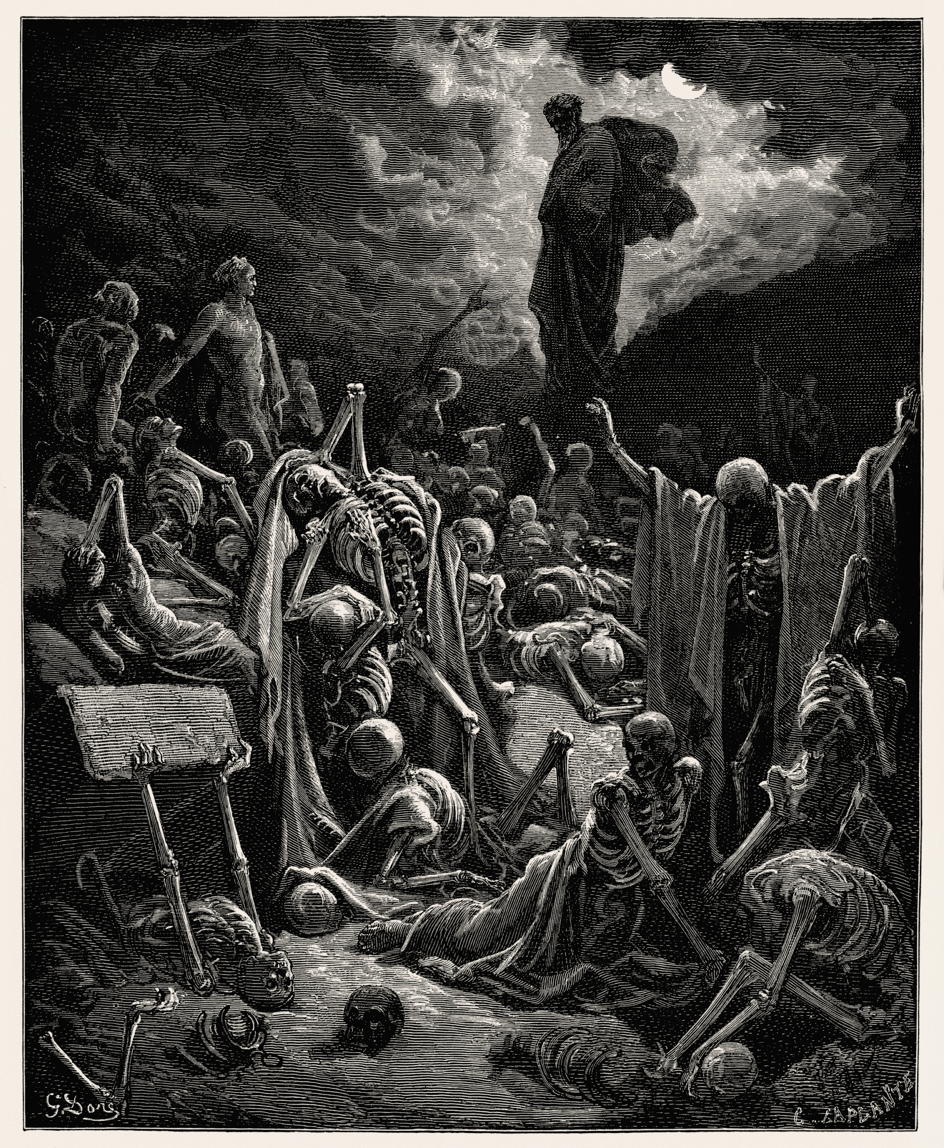
Valley of dry bones – Ezekiel 37:1-10
“Son of man, can these bones live?”
God did not simply raise up bones, he produced a breathing army from nothing
The word of God will be heard, the will of God will be done
  He can raise up whatever He wills to accomplish it

Slide 4
I KINGS 19:9-18
Elijah’s world is filled with idolatry and hatred of God
“But the Lord was not in the…”
“I alone am left”
  Elijah felt completely alone in his world
“7,000 in Israel, all the knees that have not bowed to Baal”

Slide 5
APPLICATION
We live our lives as if God CAN’T do certain things
Our faith is shaken by many things that are out of our control
Trials exist not because God can’t prevent them, but to increase our faith
He often waited until the last moment to deliver
  Abraham in Genesis 22:11-12
  Shadrach, Meshach, and Abednego in Daniel 3:16-18, 26-27
  Peter in Acts 12:6-11

