Slide 2
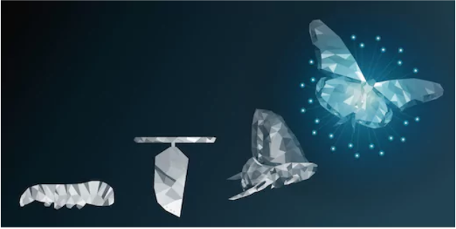
The Gospel & Transformation

Slide 3
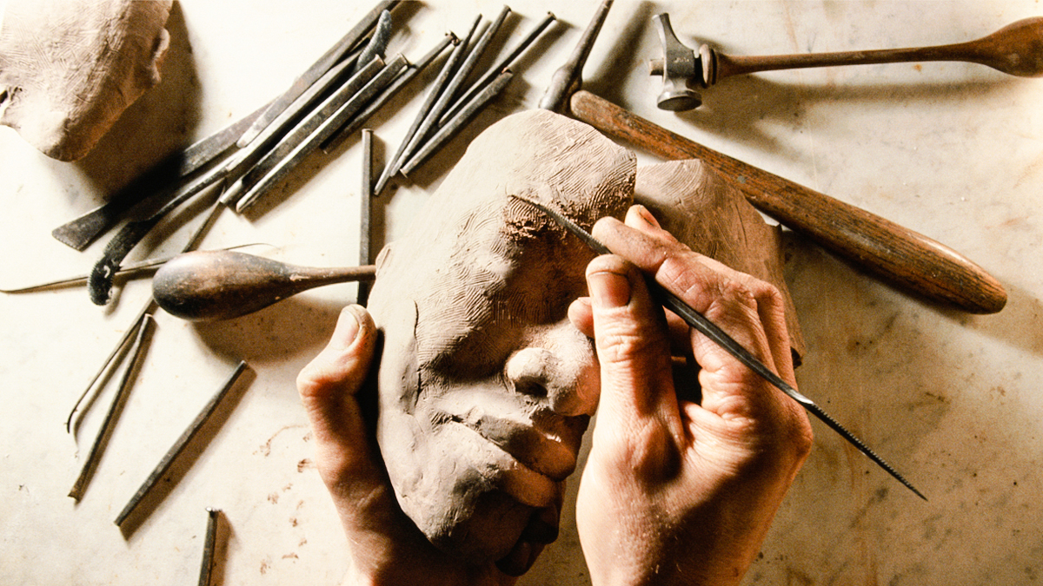
The Gospel of Transformation
“But we all, with unveiled face, beholding as in a mirror the glory of the Lord, are being transformed into the same image from glory to glory, just as from the Lord, the Spirit.”
  2 Corinthians 3:18
“I have been crucified with Christ; and it is no longer I who live, but Christ lives in me; and the life which I now live in the flesh I live by faith in the Son of God, who loved me and gave Himself up for me.”
  Galatians 2:20

Slide 4
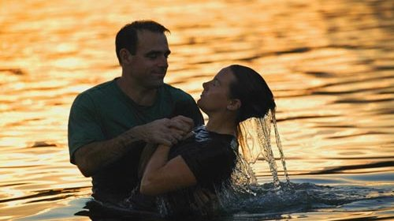
Transformation – The New Birth
“ Jesus answered and said to him, “Truly, truly, I say to you, unless one is born again he cannot see the kingdom of God.” Nicodemus said to Him, “How can a man be born when he is old? He cannot enter a second time into his mother’s womb and be born, can he?” Jesus answered, “Truly, truly, I say to you, unless one is born of water and the Spirit he cannot enter into the kingdom of God.”
  John 3:3-5

Slide 5
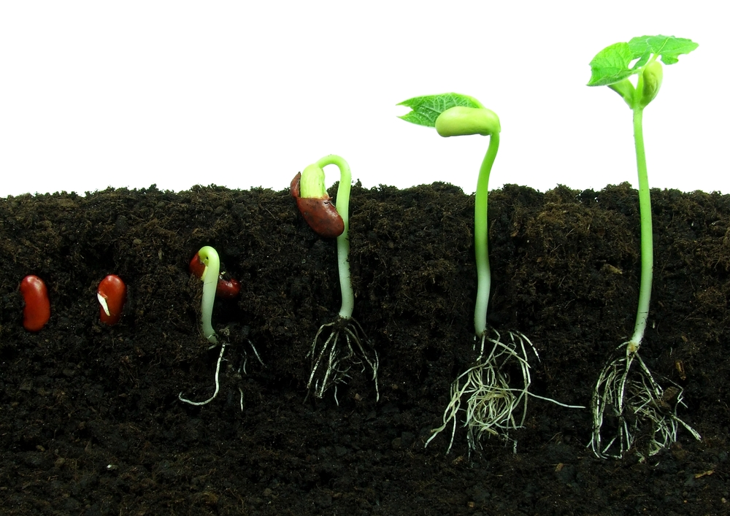
Transformation – Spiritual Circumcision
And in Him you have been made complete, and He is the head over all rule and authority; and in Him you were also circumcised with a circumcision made without hands, in the removal of the body of the flesh by the circumcision of Christ; having been buried with Him in baptism, in which you were also raised up with Him through faith in the working of God, who raised Him from the dead. When you were dead in your transgressions and the uncircumcision of your flesh, He made you alive together with Him, having forgiven us all our transgressions, having canceled out the certificate of debt consisting of decrees against us, which was hostile to us; and He has taken it out of the way, having nailed it to the cross.
  Colossians 2:10-14

Slide 6

Transformation – Death to Life
“For you have died and your life is hidden with Christ in God. When Christ, who is our life, is revealed, then you also will be revealed with Him in glory. Therefore consider the members of your earthly body as dead to immorality, impurity, passion, evil desire, and greed, which amounts to idolatry.”
  Colossians 3:3-5

Slide 7

The Work of Transformation
“ But we should always give thanks to God for you, brethren beloved by the Lord, because God has chosen you from the beginning for salvation through sanctification by the Spirit and faith in the truth. It was for this He called you through our gospel, that you may gain the glory of our Lord Jesus Christ.”
  2 Thessalonians 2:13-14

Slide 8

The Work of Transformation
“For this reason we also constantly thank God that when you received the word of God which you heard from us, you accepted it not as the word of men, but for what it really is, the word of God, which also performs its work in you who believe.”
  1 Thessalonians 2:13

Slide 9

The Work of Transformation
“Therefore I urge you, brethren, by the mercies of God, to present your bodies a living and holy sacrifice, acceptable to God, which is your spiritual service of worship. And do not be conformed to this world, but be transformed by the renewing of your mind, so that you may prove what the will of God is, that which is good and acceptable and perfect.”
  Romans 12:1-2

Slide 10

How do we accomplish this transformation?
Through the gospel’s work on our hearts
  Hebrews 4:12
  2 Timothy 3:16-17
Through enduring trials
  Romans 5:1-5
  James 1:2-4
Looking to Christ
  Philippians 3:7-8
  Hebrews 12:1-3

