Slide 3
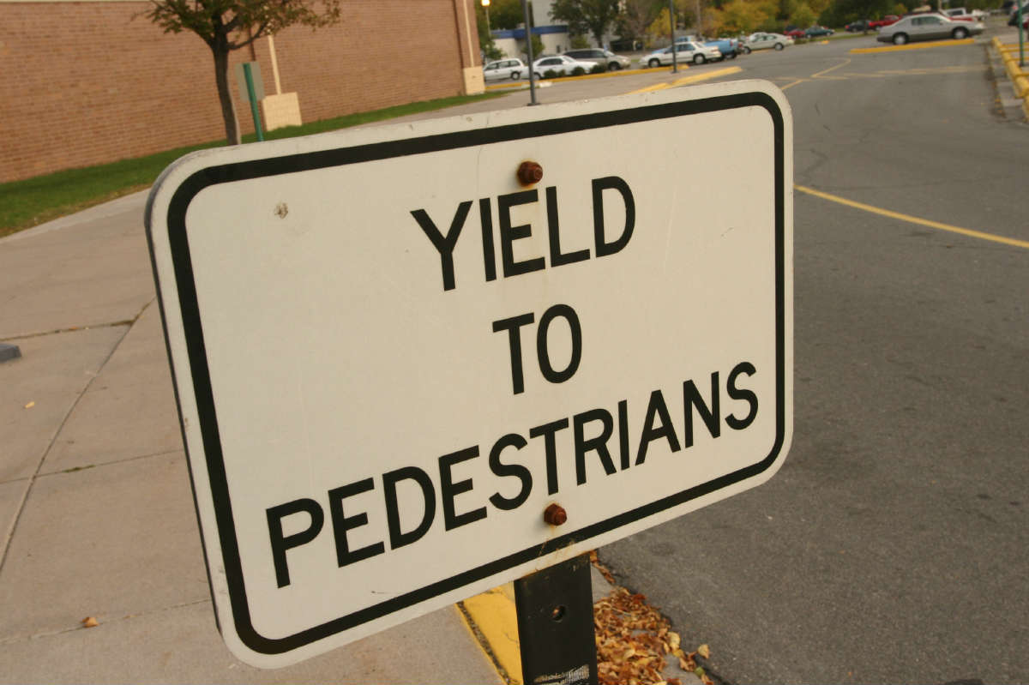

Slide 5
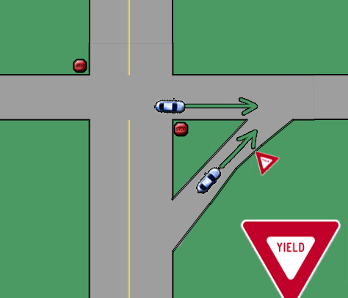

Slide 7
YIELDING
Types of Yielding
Yielding to God (Psalm 139:1-4, Luke 12:4-7, 2 Peter 3:9)
Yielding to the Holy Spirit (Matthew 28:18-20, Acts 5:32, 2:38, 7:51, Galatians 5:16, 18, 25)
Yielding to each other (Romans 12:10, 14:13, 19, 15:1-6, Ephesians 5:21, Philippians 2:3, 1 Peter 3:8, 5:5)
Yielding to Jesus (Matthew 10:37-39, 11:28-30, Luke 9:23)

Slide 8
YIELDING
This choice is not the choice most people are willing to yield to; but, if you want to go to Heaven, there is no other way except through Jesus (John 14:6, Matthew 16:24-27).

Slide 9
YIELDING
Yielding to Christ will make your life better and meaningful on this earth and will lead you to Heaven for Eternity!

