Slide 1
CHURCH EDIFICATION
Book of Titus

Slide 2
CHURCH EDIFICATION
The theme of the Book of Titus is “Church Edification” despite the fact that neither the word “Church” or “Edification” are found in this letter!
Titus 1:5 - “For this reason I left you in Crete, that you should set in order the things that are lacking...”

Slide 3
CHURCH EDIFICATION
Church (Universal) – All the saved who are called out of sin into the body of Christ, the Lord’s church (Matthew 16:18; Acts 2:47; Col.1:13; Eph.1:22-23)
Church (Local) – Christians in a local community who band together to do the work & worship the Lord has given the Church (Phi.1:1; Acts 9:26-28; 14:21-23)

Slide 4
CHURCH EDIFICATION
Edification – "the act of building" (oikos, "a home," and demo, "to build"); this is used only figuratively in the NT, in the sense of edification, the promotion of spiritual growth (lit., "the things of building up"), Romans 14:19; 15:2; 1 Corinthians 14:3, 5, 12, 26
(Vine’s Expository Dictionary N.T.)

Slide 5
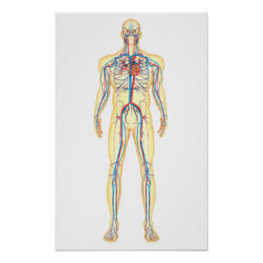
CHURCH EDIFICATION
Lev.17:11 – For the life of the flesh is in the blood
The Life Blood For The Spiritual Body Of Christ, The Lord’s Church, Is His Word!

Slide 6
CHURCH EDIFICATION
The Church Is Edified When All Members Do Their Part!
Evangelist – Responsibilities And Duties (2:1, 6, 9, 15; 3:1, 8-9) Character (2:7-8)

Slide 7
CHURCH EDIFICATION
Elders – Qualifications To Serve (1:6-9); Responsibilities (2:7-8)
Members – Older Men (2:2); Older Women (2:3-4); Younger Women (2:4-5); Younger Men (2:6-8); All Christians About Duties & Attitudes (2:9-3:15)

Slide 8
CHURCH EDIFICATION
Ephesians 4:16 - from whom the whole body, joined and knit together by what every joint supplies, according to the effective working by which every part does its share, causes growth of the body for the edifying of itself in love.

