Slide 1
DEACON QUALIFICATIONS & APPOINTMENT PROCEDURES

Slide 2
DEACON QUALIFICATIONS (part 2)

Slide 3
DEACON QUALIFICATIONS - 1 TIM. 3:8-13
“Likewise deacons must be reverent (men of dignity), not double-tongued, not given (addicted) to much wine, not greedy for money (fond of sordid gain), holding the mystery (hidden truth) of the faith with a pure (clear) conscience. But let these first be tested; then let them serve as deacons, being found blameless (beyond reproach). Likewise, their wives must be reverent (dignified), not slanderers (malicious gossips), temperate, faithful in all things. Let deacons be the husbands of (only) one wife, ruling their (his) children and their own houses (his household) well (good managers of their children and their own husbands). For those who have served well as deacons obtain for themselves a good (high) standing and great boldness (confidence) in the faith which is in Jesus Christ.” [NKJV (NASV, NIV)]

Slide 4
DEACON QUALIFICATIONS - 1 TIM. 3:8-13
Last Sunday we talked about important considerations
The Greek work “diakonos” refers to a servant and serving. The deacon is a man whose life is dedicated to serving.
The work of a deacon is an essential work. God created this work and provided specific qualifications for that work. The man who will serve must be qualified in all respects mentioned as long as he is a deacon. Deacons need to be available and responsive in order to help the brethren of the church and assist the elders.
Being a Servant means having a proper attitude, involves personal sacrifice, doesn’t wait to be asked, serves impartially, and serves eagerly.
Rewards – Good standing and great boldness in the faith (1 Timothy 3:13)

Slide 5
DEACON QUALIFICATIONS - 1 TIM. 3:8-13
We covered these qualifications from 1 Timothy 3:8-10:
“Reverent (men of dignity)”
“Not double-tongued (devious in speech)”
“Not given (addicted) to much wine”
“Not greedy for money (dishonest gain)”
“Holding to the mystery (hidden truth) of the faith with a pure (clear) conscience”
“But let these also first be tested; then let them serve as deacons”
“Being found (if they prove themselves) blameless”

Slide 6
Deacon Qualifications – 1 Timothy 3:11
The wife of the deacon: “Likewise, their wives must be reverent (dignified), not slanderers (malicious gossips), temperate (sober-minded), faithful in all things”
• The women under consideration are not female deacons, but rather the wives of the deacons and elders. “Even so must their wives be” (KJV). “Women must likewise be reverent (dignified)” (NASB). “Their wives are to be women worthy of respect” (NIV). To be admired for her character. Their wives should share the deacon’s interest in spiritual things, especially those matters where a degree of soberness and serious resolve is needed.
• “Not slanderers (malicious gossips)”; prone to insult, malign, gossip; accusing falsely. The spouse of the deacon must also be a women of discretion and able to control her tongue (James 3:6).

Slide 7
Deacon Qualifications – 1 Timothy 3:11
The wife of the deacon: “Likewise, their wives must be reverent (dignified), not slanderers (malicious gossips), temperate (sober-minded), faithful in all things”
• Due to the work of her husband, she must not make a wrong or selfish use of the confidential information to which she has access. The word “malicious” indicates that she cannot be a woman who is hyper-critical or one who is bent on finding fault with others. Slander divides and hurts people and destroys churches.
• “Temperate”: Clear-headed, self-controlled, circumspect, and like her husband, neither can she be addicted to much wine.
• “Faithful in all things”: trustworthy, reliable, and dependable. Faithful in keeping secrets, faithful in keeping appointments, faithful to her husband, her children, and faithful to God.

Slide 8
Deacon Qualifications – 1 Timothy 3:12
“Husbands of one wife”
• This would exclude the single man. Some view this as meaning that the deacon cannot be a polygamist, but polygamy is something that would have been ceased at conversion with any Christian (1 Corinthians 7:1-2; Acts 2:38; 1 Corinthians 6:9-11).
• All the other qualifications (e.g., dignity, not double-tongued) are qualities that the deacon must currently demonstrate to remain qualified. A deacon must be a scripturally married man. Any previous marriage ended in the death of his spouse (Ro. 7:1-3) or ended by putting away his spouse for adultery (Matt. 19:9).
• The one woman man is a man who is dedicated to his wife. She is an extremely important person in his life. She is his one and only. He has a strong marriage, and does not have eyes that wander (Matthew 5:28).

Slide 9
Deacon Qualifications – 1 Timothy 3:12
“Ruling (managing) their children and their own houses well”
• In addition to a wife, a deacon has children
• “Ruling” or “managing” means literally, to stand before, to lead, or attend to (indicating care and diligence) (Vine, p. 307). Being at the head of and presiding over in the appropriate and right way. He is the spiritual leader of his home (Genesis 18:17-19; Joshua 24:15).
• “He must provide for his family – financially, emotionally, and spiritually. His home must not be on the verge of collapse. Yet he is not to be a spirit-crushing tyrant. Also, the father must not be passive and disinterested in his children; the kind of man who leaves child rearing to his wife” (Strauch, p. 142).
• He is willing to do whatever is necessary to further the cause of Christ, spread the gospel, save souls, teach new converts, ground people in the faith, help people in their relationship with God, assist the elders, and to lead his family in the way God wants.
• He leads his family in harmony with God’s instruction.

Slide 10
Deacon Qualifications – 1 Timothy 3:12
“Ruling (managing) their children and their own houses well” - Related to the work of the deacon:
(1) Ability to influence people in the right way.

Slide 11
Deacon Qualifications – 1 Timothy 3:12
“Ruling (managing) their children and their own houses well” - Related to the work of the deacon:
(1) Ability to influence people in the right way. (2) Experience in dealing with and learning from problems in the lives of others as well as their own.

Slide 12
Deacon Qualifications – 1 Timothy 3:12
“Ruling (managing) their children and their own houses well” - Related to the work of the deacon:
(1) Ability to influence people in the right way. (2) Experience in dealing with and learning from problems in the lives of others as well as their own. (3) Ability to lead a responsible life and set a good example.

Slide 13
Deacon Qualifications – 1 Timothy 3:12
“Ruling (managing) their children and their own houses well” - Related to the work of the deacon:
(1) Ability to influence people in the right way. (2) Experience in dealing with and learning from problems in the lives of others as well as their own. (3) Ability to lead a responsible life and set a good example. (4) Proof of important character traits such as patience, discipline, self control, love, sacrifice, kindness, longsuffering, etc.

Slide 14
Deacon Qualifications – 1 Timothy 3:12
“Ruling (managing) their children and their own houses well” - Related to the work of the deacon:
(1) Ability to influence people in the right way. (2) Experience in dealing with and learning from problems in the lives of others as well as their own. (3) Ability to lead a responsible life and set a good example. (4) Proof of important character traits such as patience, discipline, self control, love, sacrifice, kindness, longsuffering, etc. (5) Deacons make wise decisions and earn his family’s respect.

Slide 15
Deacon Qualifications – 1 Timothy 3:12
“Ruling (managing) their children and their own houses well” - Related to the work of the deacon:
(1) Ability to influence people in the right way. (2) Experience in dealing with and learning from problems in the lives of others as well as their own. (3) Ability to lead a responsible life and set a good example. (4) Proof of important character traits such as patience, discipline, self control, love, sacrifice, kindness, longsuffering, etc. (5) Deacons make wise decisions and earn his family’s respect. (6) He is not so busy that he neglects the needs of his family and therefore would manage his time well for the needs of the church. A deacon needs to be available and responsive in order to help the church and assist the elders! A man who is too busy while being considered to be a deacon, would probably be too busy to help the church and the elders.

Slide 16
Deacon Qualifications – 1 Timothy 3:12
“Ruling (managing) their children and their own houses well” - Related to the work of the deacon:
(1) Ability to influence people in the right way. (2) Experience in dealing with and learning from problems in the lives of others as well as their own. (3) Ability to lead a responsible life and set a good example. (4) Proof of important character traits such as patience, discipline, self control, love, sacrifice, kindness, longsuffering, etc. (5) Deacons make wise decisions and earn his family’s respect. (6) He is not so busy that he neglects the needs of his family and therefore would manage his time well for the needs of the church. A deacon needs to be available and responsive in order to help the church and assist the elders! A man who is too busy while being considered to be a deacon, would probably be too busy to help the church and the elders. (7) His faith and conviction are effective within his family and therefore can be effective with the church.

Slide 17
1 Timothy 3:13 “For those who have served well as deacons obtain for themselves a good (high) standing and great confidence in the faith that is in Christ Jesus.”
• In this verse the Greek word “bathmos” appears only here for “standing” in the new testament. This word “bathmos” means “a step, a threshold. Here the meaning is a position of trust and influence in the church” (Vincent, p. 237). “Denotes a step, primarily of a threshold or stair; figuratively; a standing, a stage in a career, position, degree” (Vine, p. 155).
• Deacons who perform well will have greater confidence in their relationship with God. They will also develop greater confidence in their faith.

Slide 18
1 Timothy 3:13 “For those who have served well as deacons obtain for themselves a good (high) standing and great confidence in the faith that is in Christ Jesus.”
• There have always been those who have shied away from the responsibility of serving as a deacon, yet notice God’s attitude.
The responsibility is not to be dreaded. Rather tremendous rewards, personal growth, and spiritual growth await the man who will answer the call.

Slide 19
Deacon Nomination Process
1. All Christians who are members of the Oak Ridge church of Christ nominate men they believe meet the qualifications for deacons.
2. Those men nominated by the majority are considered.
3. Elders confirm those nominated meet the qualifications. The prospective deacons then will be asked by the elders if they are willing to serve as deacons.
4. The list of men meeting the qualifications and willing to serve as deacons is announced to the congregation.
5. After announcing the prospective deacons, there is a 2 week consideration period. During this time members are encouraged to talk to and discuss any concerns they might have with those on the list.
6. Concerns that cannot be resolved between the member and the prospective deacon during the 2 week consideration period are brought to the elders to seek resolution.
7. Once issues are resolved, the qualified deacons will be announced and appointed.

Slide 20
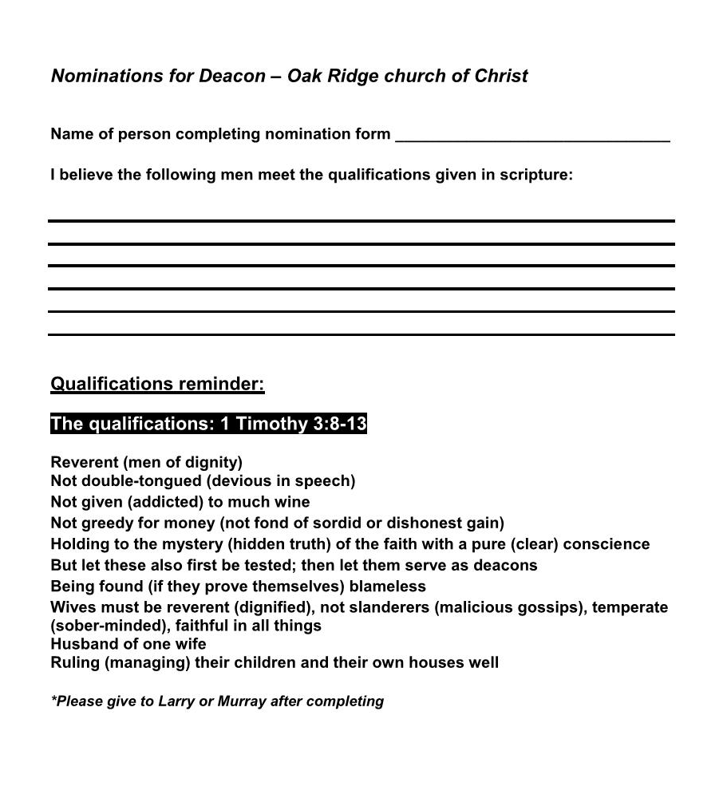
Larry and I hope to hand these out to each member Wednesday (November 8) and then have them returned to us no later than the following Wednesday (November 15).
*Think and pray about this. Consider the qualifications thoroughly. Then nominate men you believe are qualified for the work of a deacon.

Slide 21
Galatians 3:26-29
To be a slave, servant, and child of God one must put on Jesus Christ by believing Him, confessing he is the Son of God, repenting of your sins, and being baptized for the forgiveness of your sins.
Have you done these things?
For those of us who are Christians;
Am I seeking to please God each moment of my life? (1 Thessalonians 4:1)
If we can help you this morning, please come forward while we standing and sing.

