Slide 1
THE TRANSFORMATION OF ME

Slide 2
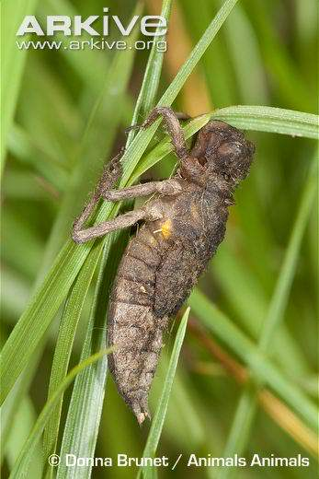

Slide 3
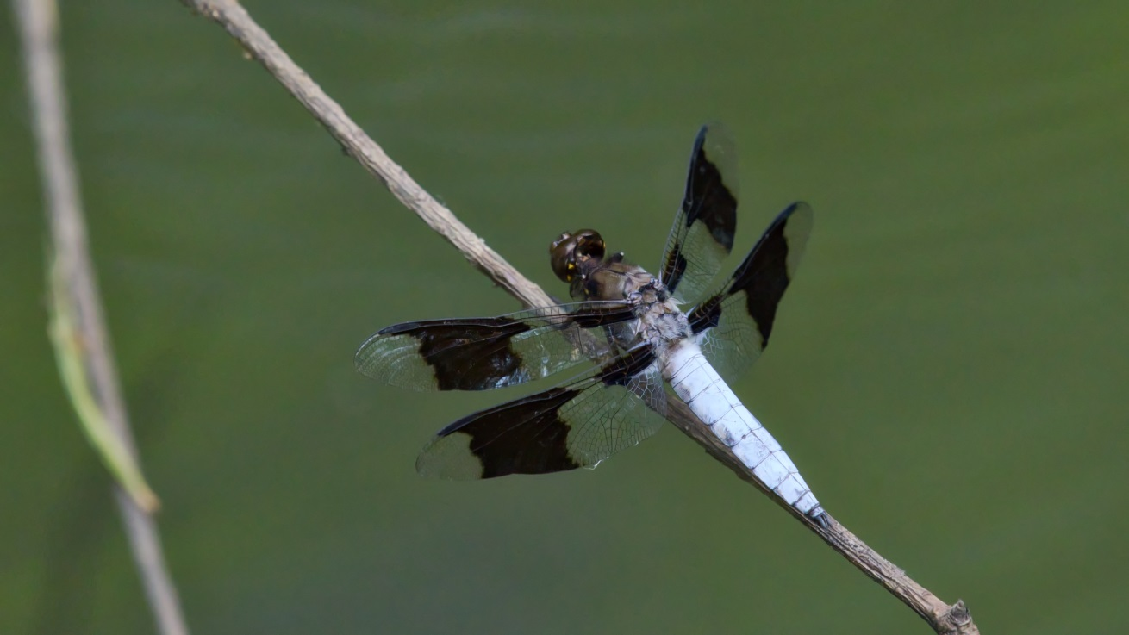

Slide 5
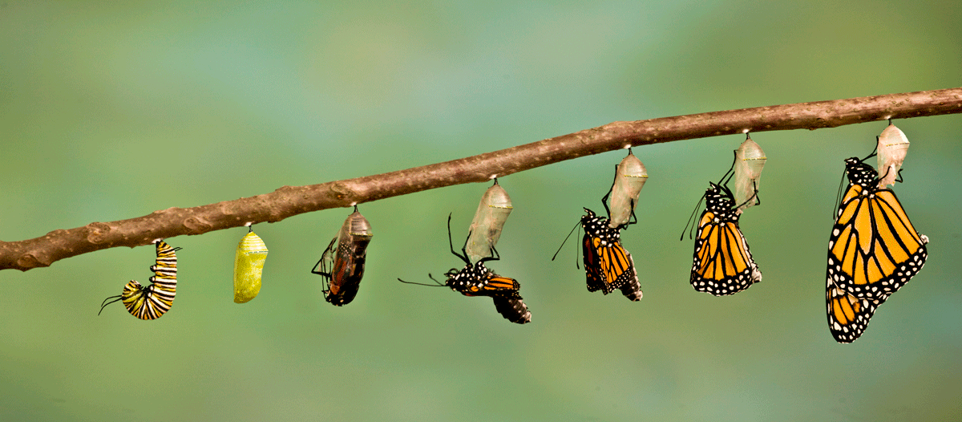

Slide 6
THE TRANSFORMATION OF ME
We are to be transformed by the renewing of our minds (Romans 12:1-2).
We are undergoing a transformation process to change over time into the image of God (2 Corinthians 3:18).
This transformation is a life-long growth process.

Slide 7
THE TRANSFORMATION OF ME
Our life is transformed by:
1. Valuing a person’s soul as much as Jesus (Mark 8:34-38).

Slide 8
THE TRANSFORMATION OF ME
Our life is transformed by:
2. Not conforming ourselves to this world (Matthew 6:19-21, 1 Timothy 6:17-19).

Slide 9
THE TRANSFORMATION OF ME
Our life is transformed by:
3. Focusing on the spiritual rather than the physical (Luke 12:13-21, John 4:7-10).

Slide 10
THE TRANSFORMATION OF ME
Our life is transformed by:
4. Seeking and saving those who are lost (Hebrews 4:12, Ephesians 6:17; Acts 8:4, 17:1-3, 16-17).

Slide 11
THE TRANSFORMATION OF ME
Our life is transformed by:
5. Being more like Jesus each day (2 Peter 1:5-7; 2 Corinthians 13:5, James 1:25).

Slide 12
THE TRANSFORMATION OF ME
We Christians look forward to the completion of our transformation as Christ transforms our lowly body to be like His glorious body (Philippians 3:20-21, 1 Corinthians 15:51-58). Then we will be able to fly like the dragonflies and butterflies!

Slide 13
THE TRANSFORMATION OF ME
The Transformation of Me
How are you doing with your transformation?

Slide 14
THE TRANSFORMATION OF ME
Romans 6:3-7 (ESV): Do you not know that all of us who have been baptized into Christ Jesus were baptized into His death? We were buried therefore with Him by baptism into death, in order that, just as Christ was raised from the dead by the glory of the Father, we too might walk in newness of life. For if we have been united with Him in a death like His, we shall certainly be united with Him in a resurrection like His. We know that our old self was crucified with Him in order that the body of sin might be brought to nothing, so that we would no longer be enslaved to sin. For one who has died from sin has been set free from sin.

Slide 15
THE TRANSFORMATION OF ME
The Transformation of Me
Once baptized, you will be appealing to the Lord and can start your journey toward eternal perfection!
Please come now as we stand and sing!

