Slide 1
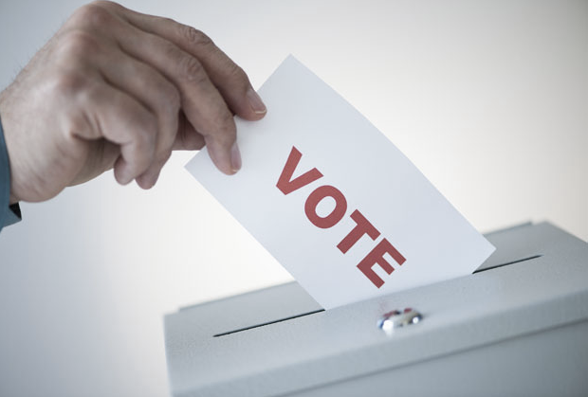
The Christian and Voting

Slide 2
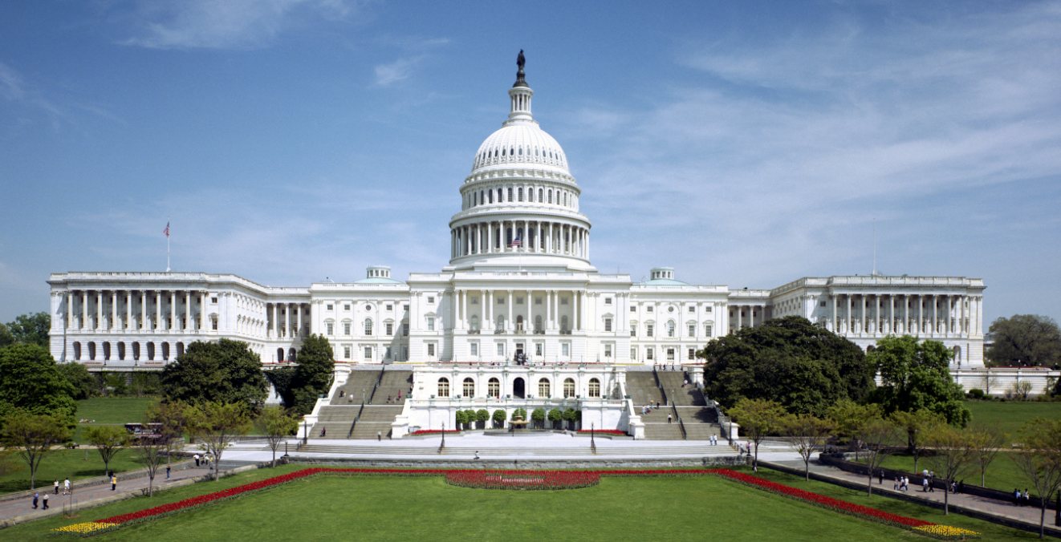
Topics already covered
Nationalism
America is no greater than any other country
God has no desire for a “Christian” nation
What is your motivation for voting?
Pride, conceit, selfish-ambition, spite?
Notes:
Before we get into today’s lesson let’s look back at the topics we’ve covered so far and how they should affect who a Christian should vote for.
1st we covered the danger of turning our nationalism into an idol. We have to realize America is no greater or worse than any other country, and God never expresses any desire for a physical “Christian” nation. In fact, Jesus stresses many times that is not the case.
Next we looked at if we are voting with the right attitude when we vote. Is someone running for office you don’t like and so you vote for the other person out of spite? Are you trying to advance your own career and think you are so much greater than the other candidate? If we vote with a sinful attitude are voting is sinful regardless of who we vote for.

Slide 3
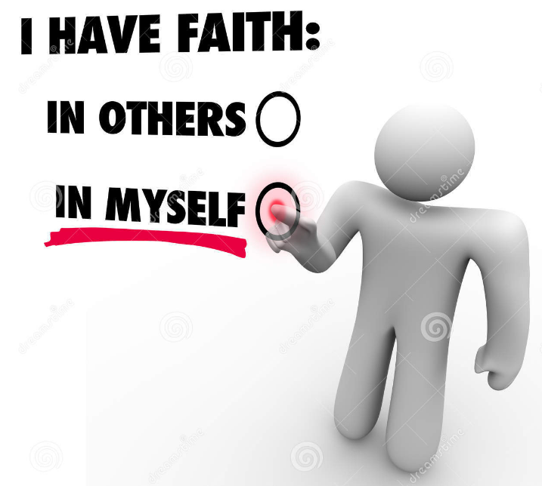
Topics already covered (cont’d)
Does our vote reflect our reliance on God or ourselves?
Economic policies
  Vote so I will be better off financially
  Vote against someone because there is no way that economic policy would work
Gun Policy
  I will protect myself
  I’ll only be safe if no one has guns
Romans 8:28
Notes:
We then waded into two seemingly unrelated topics, the economy and gun rights. However, upon a little further investigation you can see that both of these issues can be boiled down to how much are we willing to rely on God.
Frist we looked at economic policies and saw the danger in using that as a determining factor in how we vote. Sometimes we vote for someone whom we think will make us better off financially, other times we vote against someone because there is no way there financial system would work. And ultimately we saw we were completely deleting God from the equation and relying on our own wisdom, understanding and ability to care for ourselves to make our decision. The bible as numerous verses saying we should put all our trust in God, that we shouldn’t worry about money, and we shouldn’t trust in our money. So why would we make money such a critical issue when it comes to how we vote?
Then we looked at gun policy and saw that we can fall into the same trap as people do with economic policy. The idea that I can take care of myself. I won’t be safe if people can own guns, I’ll vote against it. I need a gun to keep my home safe, I vote for guns. Ultimately, God is again being deleted from the equation and we are relying on worldly wisdom to guide our decisions. A lot of arguments for and against guns deal with “what if scenarios.” Well, Jesus literally had people wanting to and trying to kill him, and they ultimately did kill him. We have no record of him ever carrying a weapon. Jesus trusted in God, we should too.

Slide 4
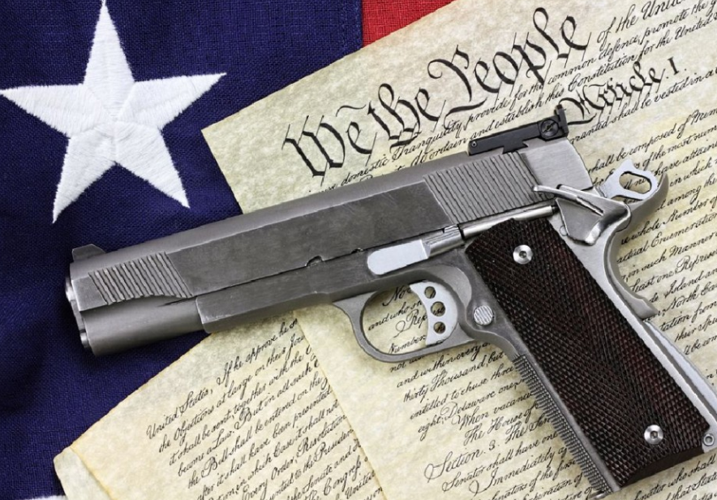
Are any of these things inherently evil?
None of the previous 4 topics deal with anything inherently evil
  Nationalism can be fun (think Olympics, World Cup, etc.)
  I can be motivated to vote for someone because I like them
  I think we should have free trade to help other countries/we shouldn’t have free trade because our own country needs help
  I collect guns and hobby/It’s harder to murder someone without a gun
Notes:
In all of the cases we’ve discussed so far, none of them are inherently evil.
Nationalism can be fun.
I can have perfectly pure motivations for voting for someone.
You can vote on economic policies based on how you feel others can benefit.
A lot of people collect guns. They never intend to ever shoot them, they want to put them in a glass case. Other people hobby shoot. Innocent activities you need a gun to enjoy. Or maybe you’re motivated by the logic that people without guns aren’t going to be able to kill people as easily.

Slide 5
What about issues that are inherently evil?
Notes:
While those topics, most of us will agree, Christians don’t have to take a stand on and we shouldn’t waste too much effort defending our views on them.
There are other topics that come up in elections that we’d agree do necessitate our attention and that we take a stand.

Slide 6
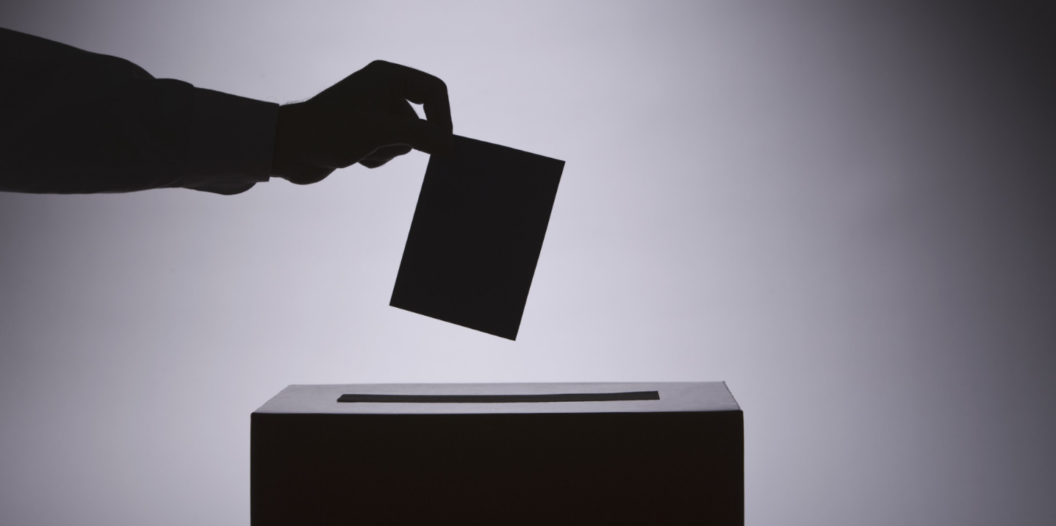
You don’t vote “against” someone by voting for the other person
Your vote is your endorsement of a particular person or party
You can’t mark on the ballot whom you are voting against, just the person you choose to back.
Notes:
1st I want to tackle a common misconception about voting and how lots of people vote.
There’s no such thing as voting against someone. You can’t do it. Your only option is to vote for someone on the ballot. I think it brings a lot of people a false sense of ease about their voting decision if they convince themselves they’re voting for the lesser of two evils. If that’s the case, at the end of the day you still voted for evil.
When voting though, we aren’t voting for religious leaders, we are voting for civil leaders, and the same standards don’t and shouldn’t apply.
But as we go through the next few slides keep in mind that there is no such thing as voting against someone, only voting for someone.

Slide 7
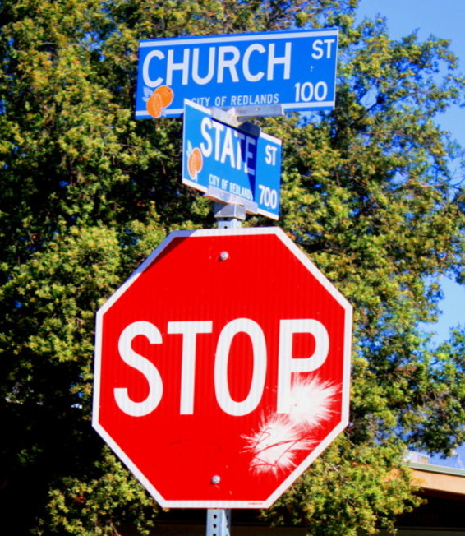
Making Christianity Illegal
Matthew 10:5-15
    “more tolerable for Sodom and Gomorrah than for that town”
The O.T. is full of examples of nations rejecting God and the judgment they incurred.
    Egypt, Canaan, Israel, Judah, Assyria, Babylon, Persia, Romans(NT)
God will tolerate a lot, but he never tolerates a people that full-heartedly reject him
  Hosea 13
Notes:
The first thing that is inherently evil that we should consider when voting is religious liberties, or the reduction thereof. It’s still hard to fathom banning Christianity will be on the voting platform of any candidate in this country but it’s always a possibility. You don’t need me to tell you Christianity, or at least people’s perception of it, isn’t very popular in this country right now.
However if there is ever a candidate that wants to make teaching and spreading the gospel illegal, I think we can all agree we should vote for the other person.
But what if the other person supports this, this and this evil thing?
That may be true but is there anything worse someone can do than preventing people from coming to Christ?
The bible is full of examples of nations whole heartedly rejecting God. The result is nations that no longer exist. There are almost endless verses about all these nations but I want to read about God’s opinion of Israel, after they rejected him.

Slide 8

Abortion and Homosexuality(LGBTQ)
Unborn babies are ‘alive’ (Gen. 25:21-13, Ex. 21:22-23, Matt. 1:18-20, Lk. 1:41-45)
Murder is wrong (Deut. 5:17, Prov. 6:16-17, Rom. 13:8-10)
Homosexuality is wrong (Lev. 18:22, Rom. 1:26-28, 1 Cor. 6:9-11)
However, should we completely qualify, or disqualify, a candidate based on where they stand on these two issues?
Notes:
I want to lump abortion and homosexuality into one category because these are the sins where Christians will always draw a line. “I a candidate supports this, I won’t vote for him.”
To be perfectly clear, both abortion and homosexuality are wrong. Here are a lot of verses dealing with both topics, I don’t want to discuss these topics in detail because we all already know a lot about them.

Slide 9
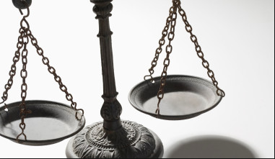
Rating Sin
When we hold one sin to a higher degree of severity than others we become judges
  Matthew 7:1-2
Romans 6:23 – wages of sin is death
  It doesn’t distinguish which sins, it just says “sin”
Which sin is worse?
  1 Corinthians 6:9-10, Galatians 5:19-22, 1 Timothy 1:8-10, Revelation 21:6-8
Notes:
A trap many Christians fall into is that we rate the sin. Over time, these two have become the pinnacle of evil in our society. Let’s make no mistake, those sins are evil, but are they of such greater evil that they are the end all be all for our support of a politician.
When we set one sin above all others we become a Judge. We aren’t being a judge for condemning a sin the bible tells us we are to condemn. We’re a judge because we’ve decided that one sin is worse than another. A view that’s inconsistent with what we learn in the bible.
There are several “sin lists” in the bible. And the fact of the manner is some sins are considered much more condemnable in these lists than others. But I’ve never heard someone say, I’m not voting for that person because they’re a liar. I won’t vote for candidate ‘A’ because they support homosexuality. I know candidate ‘B’ is a liar but I’ll still vote for him.

Slide 10

1 Corinthians 6:9-10
Hillary Clinton
Donald Trump
Supports abortion – murder
Supports homosexuality
Reviler – abusive criticism
Swindler – Trump university
If you disqualify a candidate based on things they support/do you have to be consistent!
Notes:
Here’s a simple exercise to demonstrate my point.
Here are both candidates in this year’s upcoming election. Let’s read 1 Corinthians 6:9-10 and see which candidate we should vote for after we read.
On the left we have Hillary she’s a supporter of abortion which is murder, and she supports homosexuality which is also wrong so clearly we can’t vote for her. On your right we have Donald. He’s a reviler which is also clearly wrong, and he’s a swindler. Well we can’t vote for him either. Right?
If we are consistent we can’t with good conscience vote for either candidate.
In 2012 Obama supported abortion but Romney is a Mormon. Which is worse? A candidate that openly supports a false religion that is trying to convert people to it or abortion the murder of babies?

Slide 11
So how should a Christian vote?
Focus on the good the candidate plans to do
  You can disqualify any human if your standard is perfection
Galatians 5:22-23
  Which candidate displays these qualities?
Notes:
So I’ve said a lot about reasons we shouldn’t vote for people but that doesn’t really help us when it comes to selecting an option on the ballot.
So how should the Christian vote?
Instead of focusing on the bad things the candidates are doing or proposing try focusing on the good things the candidate plans to do.

