Slide 1

Let us be concerned about one another in order to promote love and good works.
Hebrews 10:24 HCSB
Notes:
Preached:
2013-07-21 ORCOC
2013-09-08 Athens
2017-26-03 ORCOC
Scripture Reading: Hebrews 10:19-25
Key Text: Let us be concerned about one another in order to promote love and good works
Read: Hebrews 10:19-25
“Promote” above:
Promote
Stir up
Stimulate
Lets look at this word deeper [CLICK]

Slide 2

Paroxysmos (Strong's G3948)
    Provoke (Hebrews 10:24)
    Contention (Acts 15:39)
Notes:
Strong’s 3948 used twice in Bible
Provoke – Hebrews 10:24
Contention (disagreement) – Acts 15:39
“And the contention was so sharp between them, that they departed from one from the other: and so Barnabas took Mark, and sailed to Cyprus”
Defined as:
1) an inciting, incitement
2) Irritation
STRONG WORD!
Back to Hebrews 10:19-25 (24-25) in particular
[CLICK]

Slide 3
Promote love and good works
Encourage each other
Notes:
Hebrews 10:24-25: “And let us be concerned about one another in order to promote love and good works, not staying away from our worship meetings, as some habitually do, but encouraging each other, and all the more as you see the day drawing near.”
Another passage in Hebrews on encouraging:
Read: Hebrews 3:12-13
“¹² Watch out, brothers, so that there won’t be in any of you an evil, unbelieving heart that departs from the living God. ¹³ But encourage each other daily, while it is still called today, so that none of you is hardened by sin’s deception.”
In both Hebrew passages the word translated encourage is Strong’s G3870, translated exhort in the KJV, also beseech, comfort:
to call to one's side, call for, summon
to admonish, exhort
to beg, entreat, beseech
to console, to encourage and strengthen by consolation, to comfort
to instruct, teach
Why are we being exhorted to be on guard, encourage each other daily, to join together?
[CLICK]

Slide 4

Feeling Discouraged:
    Is not itself a sin
    Can result in sin
    Can be due to others
    Can be a result of sin
    Can be overcome
Notes:
Feeling Discouraged:
Some may have thought, heard, or promoted that feeling discouraged is a sin
Arguing “As a Christian we have so many blessings we have no right to be discouraged”
When we think about it, defined: Discouraged: deprived of confidence, hope, or spirit; dissuaded or deterred; hampered; hindered.
Being discouraged cannot be a good thing and therefore must be sinful
I disagree [CLICK], discouragement is rather the temptation to commit the sins of:
Sin:
Inaction (Revelation 3:14-22, spew you out)
Not growing (1 Corinthians 3:1-3 milk)
Staying discouraged which leads to:
Not encouraging others (perpetually) (Hebrews 3:12-13)
Are a discouragement to other (perpetually) (Luke 17:1-2 milestone)
Many more…[CLICK]
There are many sources of discouragement [CLICK] Others
I told you so… (example of house with Dad, would you ask for help?) <Note for readers on the web, Dad did not say I told you so>
Your good work lost (Galatians 4:11 – preach in vain)
Unsupportive others beating you down
David: Psalm 142:3-4 “3 Although my spirit is weak within me, You know my way. Along this path I travel they have hidden a trap for me. 4 Look to the right and see: no one stands up for me; there is no refuge for me; no one cares about me.”
e.g. for us: door knocking, dismissive
Result of sin [CLICK]
You give into temptation, sin and are thus discouraged (diet example)
David experienced this also – Psalm 38:1-14 TALKABOUT DISCOURAGED! But…
Can be overcome [CLICK]
Psalm 38:15-22 – turn to God, confess, repent, plead for help
Psalm 142:5-6 – “5 I cry to You, Lord; I say, “You are my shelter, my portion in the land of the living.” 6 Listen to my cry, for I am very weak. Rescue me from those who pursue me, for they are too strong for me.”
God is still available to the Christian today:
Hebrews 13:5 “…I will never leave you or forsake you.”
1 John 1:9 “If we confess our sins, He is faithful and just to forgive us our sins and to cleanse us from all unrighteousness”
Work to encourage others, God left us with an example: Joseph!

Slide 5
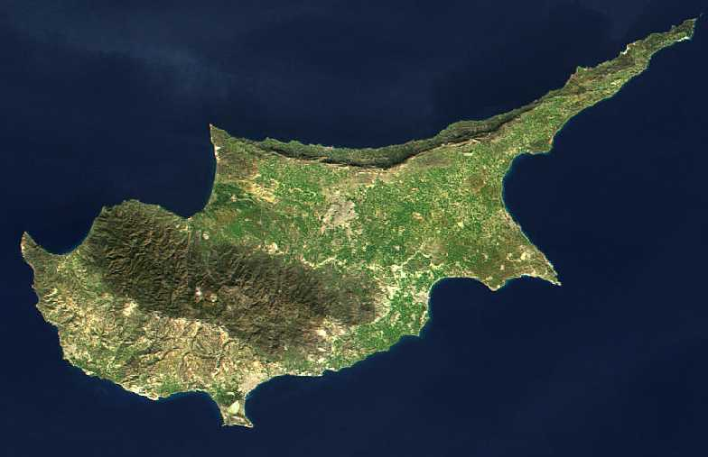
Barnabas, the Son of Encouragement
Acts 4:36
Notes:
Lets read about Joseph who is better known as Barnabas! Acts 4:36
“³⁶ Thus Joseph, who was also called by the apostles Barnabas (which means son of encouragement), a Levite, a native of Cyprus”
Barnabas means son of encouragement! WHAT A NICKNAME!
(quick story of nicknames…Negative - Opie… Positive – Big Red)
What a fitting name:
It was Barnabas who introduced Paul to the Christians in Jerusalem when no one would believe Paul - Acts 9:27
When word came that people were believing in Christ in Antioch, it was Barnabas who was sent to encourage their growth - Acts 11:19-26. Notice it was Barnabas once again who brought Paul in to preach.
When God requested two men to be sent out to preach the gospel, it was Paul and Barnabas who were picked to go - Acts 13:2 WOW!
When Paul didn’t want to take John Mark on their second trip because John Mark quit on them during the first trip, Barnabas insisted taking him along -- to the point of going separately - Acts 15:37-40 (most probable John Mark went on to write the book of Mark!)
Lets look at: Romans 12:3-8, each of us have different strengths, some better than others at various things
The church needs men and women today that will encourage others by teaching sound doctrine, by living pure moral lives (example), by enjoying helping others, by enjoying teaching their children about God. The church also needs older Christians to teach the younger by word and example how important and gratifying it is to be a child of God. The church needs younger Christians that are unafraid to stand against immorality and ungodliness in the world today.
The church needed Christians who show enthusiasm in doing the will of God!
Too many Christians walk around mopey and dead, as if there is no hope. [CLICK]

Slide 6
We have a strong encouragement to seize the hope set before us.
Hebrews 6:18 HCSB
Notes:
Where is our hope?
GOD: Hebrews 6:17-20
JESUS:
Luke 2:25 – Israel’s Consolation
Luke 2:38 – Redemption of Jerusalem
The Mystery – God’s word is for all (Ephesians 3:(3-5)6, Acts 10:34 – Peter says God shows no favoritism, i.e. we can all be saved
Jesus is our consolation, redemption for all mankind
If you need help of the saints here, let it be known
brian.andrews@oakridgechurch.com

