Slide 1
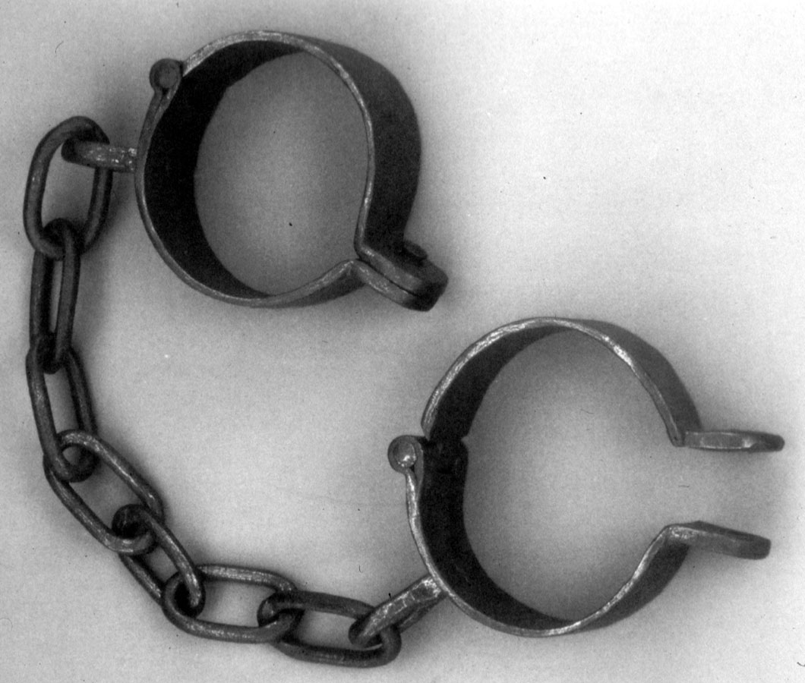
Slavery: Did the Bible get Slavery Wrong?

Slide 2
Moral Issue of Slavery
Christians may not see or even think about a potential contradiction
It is a pivotal argument for many who try to discredit the scriptures
Can be a major stumbling block if misunderstood
  Articles and books have been written using slavery to discredit the Scriptures

Slide 3
“Slave, Slavery, Bondservant”
Many Hebrew and Greek words were translated as “slave” or “slavery”
Hebrew
  `ebed
    slave, servant, man-servant
    servants, worshippers (of God)
    servant (in special sense as prophets, Levites etc)
  'amah
    maid-servant, female slave, maid, handmaid

Slide 4
“Slave, Slavery, Bondservant”
Greek
  Doulos
    a slave, bondman, man of servile condition
    devoted to another to the disregard of one's own interests a servant, attendant
  Andrapodistes (only used in 1 Tim. 1:9-11)
    a slave-dealer, kidnapper, man-stealer
    of one who unjustly reduces free men to slavery
    of one who steals the slaves of others and sells them
  Douleia
    slavery, bondage, the condition of a slave
    Used 5 times in Romans, Galatians, and Hebrews

Slide 5
Bible Slavery ≠ American Slavery
Israelite slavery was NOT for life without freedom
  Exodus 21:1-11
  Deut. 15:12-18
Slavery was a way to relieve debt or simply survive
  No welfare or bankruptcy laws
  Leviticus 25:35-46
  Israelite slavery was very similar to indentured servitude
Year of Jubilee

Slide 6
Bible Slavery ≠ American Slavery
Masters were held accountable for the way that they treated their slaves
  Exodus 21:20, 26-27
  Slaves were given rights even during servitude
  Mistreatment of a fellow Israelite had consequences regardless of their status
Slavery as practiced in America was punishable by death under the Old Law
  Exodus 21:16
  I Tim. 1:9-11 – “kidnappers” or “menstealers”

Slide 7
Slavery as Punishment
Bible had more than one type of slavery
Leviticus 25:44-46
Israel was in captivity many times because of their sin
God in turn allowed Israel to enslave pagan nations to show His displeasure with their sin

Slide 8
Argument: The Bible mentions sinful events and does directly condemn them, thus it must be alright.
  Mark 10:2-9
  Jesus added to many of the OT commands
We have to take the entirety of God’s commands to decide if a practice is lawful or not

